Slide 1
Integration Bus
2/25/2013 Miro Remias, Solution Architect

Slide 2
Agenda
General Purpose Integration Options
REST, Kentico API, Scheduled tasks, Event Handlers, Integration bus
Integration bus
Main idea
How it works
Inbound & outbound direction
Synchronous & Asynchronous task processing
Example: Sample implementation

Slide 3
General Purpose Integration Options
REST (READ, INSERT, UPDATE, DELETE)
Used when there is NO DIRECT access to Kentico DB (or via Kentico API) from external system,
Example: Client application for administrators to access Kentico Event Log,
Outbound direction: needs to be ensured FROM the external system - NOT a REAL TIME synchronization,
NO notifications about system changes,
Possible solution: Event handlers (trigger for events),
Both directions:
NO processing (task) QUEUE – what if processing fails?
Using Kenico API / controls outside of Kentico
Requires DIRECT access to Kentico DB (connection string),
REAL TIME data access,
Event handlers
REAL TIME synchronization ONLY for OUTBOUND direction,
NO QUEUE if processing fails,
Processing within page request – could SLOW DOWN the web site.
Custom scheduled task(s)
Run in the context of the web site or as windows service,
NOT mentioned for a REAL TIME synchronization,
Option to set the execution interval to 1 second – DON’T DO IT!,
Example: Synchronization of objects (e.g.: contacts) to external system (e.g.: SalesForce),

Slide 4
System Integration Bus
Kentico CMS
External System
Connector
What is the main idea?
What is the connector?
What was the goal?
When to use it ?
More advanced scenarios where REST Service is not enough
Active notifications about changes in CMS are needed
Robust processing of incoming tasks is required - task queue!

Slide 5
Sample Scenarios
#1 External logging of document modifications
Why integration bus?
REST module CAN NOT be used – on demand solution,
If external system is DOWN, changes are still logged in Kentico and can be processed later once the external system is UP and RUNNING,
Possibly you can use Event Handlers (triggers) – NO QUEUE if processing fails!
#2 Products added to external system are automatically imported to the CMS
Why integration bus?
REST CAN BE used if you DO NOT require failed product processing.

Slide 6
Direction From The CMS (Outbound)
Kentico CMS
External System
Objects
Subscription 1
Connector
Documents
Subscription 2
<XML>
Tasks
logging
<Type-safe object>
Tasks
processing
DB
Tasks queue
Subscriptions
Tasks queue
Data stored as XML in database

Slide 7
Direction From The CMS – Synch Types
Synchronous Asynchronous
NOTE: The same applies also for documents.
Object action
Object action
Thread
Object processing
Task logging
CMS Object
XML
DB
Tasks queue
CONTEXT IS AVAILABLE!
ACCESS TO PROPERTIES LIKE Parent or Children
OBJECT CAN BE LOST!
SLOWS DOWN PAGE PROCESSING!
Object processing
CMS Object

Slide 8
Type Of Data - Subscription
Snapshot – this type is useful when you want to synchronize multiple objects at once. E.g. a main object with its children, e.g. polls together with poll answers.
SimpleSnapshot – use this type when you are planning to synchronize whole objects and when you want to preserve foreign key bindings (translations).
Simple – use it when you are interested only in partial contents of an object (e.g. a text field), i.e. when you are not planning to synchronize the whole object.
Simple
SimpleSnapShot
SnapShot
Value | Objects | Documents | Synch | Asynch | Translation data (only for Asynch) | Child objects, bindings, categories etc.
SnapShot | YES | NO | YES | YES | YES | YES
SimpleSnapShot | YES | YES | NO | YES | YES | NO
Simple | YES | YES | NO | YES | NO | NO

Slide 9
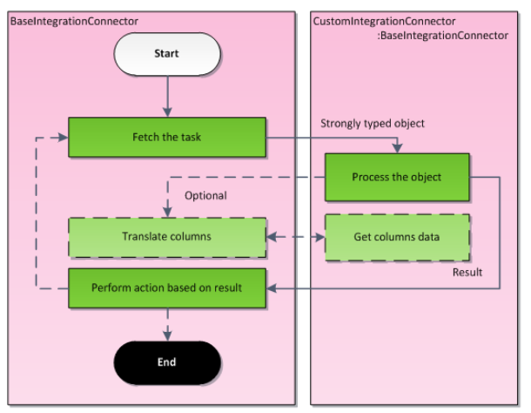
Asynchronous Processing - Direction From The CMS
External system
Connector starts to fetch tasks from the oldest to the newest,
Task is transformed to a strongly typed object and passed to the methods implemented by the developer in the connector class.
Some additional methods might be called, e.g. when a foreign key translation is desirable.
When the task is processed, the result value is returned to notify the connector - the connector decides what to do next.

Slide 10
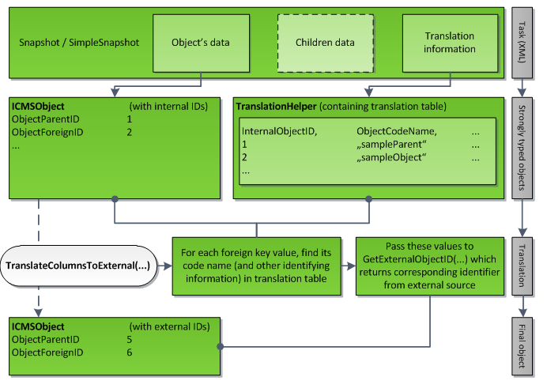
Translation Management – Asynchronous Processing
NOTE: You can transfer columns also of child objects – useful for ‘SnapShot’ data type .

Slide 11
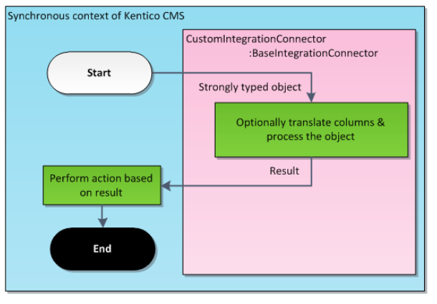
Synchronous Processing - Direction From The CMS
Processing of synchronous tasks starts immediately after some object or document matching some subscription is changed.
Unlike the asynchronous processing where the logging and processing is postponed till the application reaches EndRequest, this type of processing sends the data instantly to the subscribed connectors.
External system
NOTE:
CONTEXT IS AVAILABLE!
OBJECT CAN BE LOST!
EXCEPTION/ERROR LOGGED IN KENTICO EVENT LOG.
SLOWS DOWN PAGE PROCESSING!
NO TranslateColumnsToExternal() method, custom implementation needed!

Slide 12
Direction From The CMS – Implementation I/III
We should be decided:
• Which objects and/or documents you want to synchronize,
• Which data type you want to use,
• Whether you want to use the synchronous or the asynchronous mode,
Sample Scenario
Event booking attendees – TWO WAY synchronization with external web site.
KENTICO
EXTERNAL SYSTEM

Slide 13
Basic Classes – Direction From CMS II/III
Base connector class
BaseIntegrationConnector
Init()
Method to override initialization of the connector defining
ConnectorName property and subscriptions
Subscriptions
ObjectIntegrationSubscription, DocumentIntegrationSubscription
Classes for subscriptions - defining process type, task type
Other helper methods in base connector SubscribeToXXX()
SubscribeToObjects(), SubscribeToAllDocuments()…
CustomConnector
BaseIntegrationConnector
Subscription1
Subscription2
Methods to be implemented
ProcessInternalTaskAsync - ensures asynchronous processing of objects or documents (depending on the chosen override).
GetExternalObjectID - used in asynchronous processing for ID translations when synchronized objects or documents reference objects inheriting from BaseInfo.
GetExternalDocumentID - used in asynchronous processing for ID translations when synchronized objects or documents reference documents (TreeNode).
ProcessInternalTaskSync - ensures synchronous processing of objects or documents (depending on the chosen override).

Slide 14
Direction From The CMS – Implementation III/III
Task processing options
Utilize API of the external system if you add references to its namespaces.
Use CMSConnectionScope and GeneralConnection and perform a query upon the external database.
Push the data to an external endpoint in a format which it is able to consume -e.g. by a web service existing in the external system.
Are there other ways?

Slide 15
Direction To The CMS I/II (Inbound)
Connector DLLs in external system
External System
Kentico CMS
Connector
Objects
Documents
<Type-safe object>
Tasks
processing
Tasks
logging
DB
<XML>
Tasks queue

Slide 16
Direction To The CMS II/II
Connector DLLs in CMS using service
External System
Kentico CMS
Service
(Web, WCF)
Connector
Objects
Documents
<XML>
Tasks
logging
<Type-safe object>
Tasks
processing
DB
Tasks queue

Slide 17
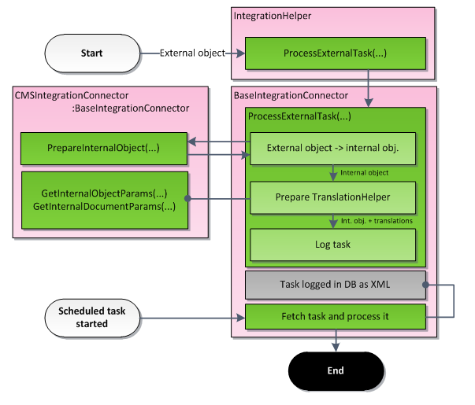
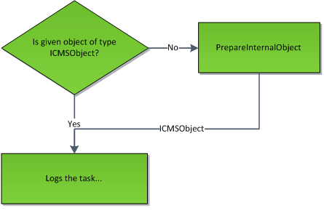
Task Processing - Direction To The CMS
ALTERNATIVES:
• Making a request to a special page
(~/CMSPages/IntegrationNotify.aspx)
NOTE: Can be done with Kentico API.
• Manually by clicking Synchronize in UI.

Slide 18
Direction To The CMS - Implementation
The following methods need to be implemented to ensure synchronization in the inbound direction:
PrepareInternalObject - ensures processing of an object or a document.
GetInteralObjectParams - prepares translation information for an object or a document that has a foreign key to an object (BaseInfo).
GetInternalDocumentParams - prepares translation information for an object or a document that has a foreign key to a document (TreeNode).
KENTICO
EXTERNAL SYSTEM
WEB SERVICE

Slide 19
Summary
Robust solution with built-in QUEUE
Task processing – ONE BY ONE,
TEST the performance of your connector,
Might NOT BE suitable FOR simple scenarios,
Think about other options (REST, HANDLERS, SCHEDULED TAKS etc.),
Future plans
Support for bulk operations to reduce amount of transactions,
General service to be called from external system,

Slide 20
Contact
Miro Remias
e-mail: miro@kentico.com
consulting: http://www.kentico.com/Support/Consulting/Overview

