Slide 1
Development In Kentico 7
11/23/2012 Miro Remias, Solution Architect

Slide 2
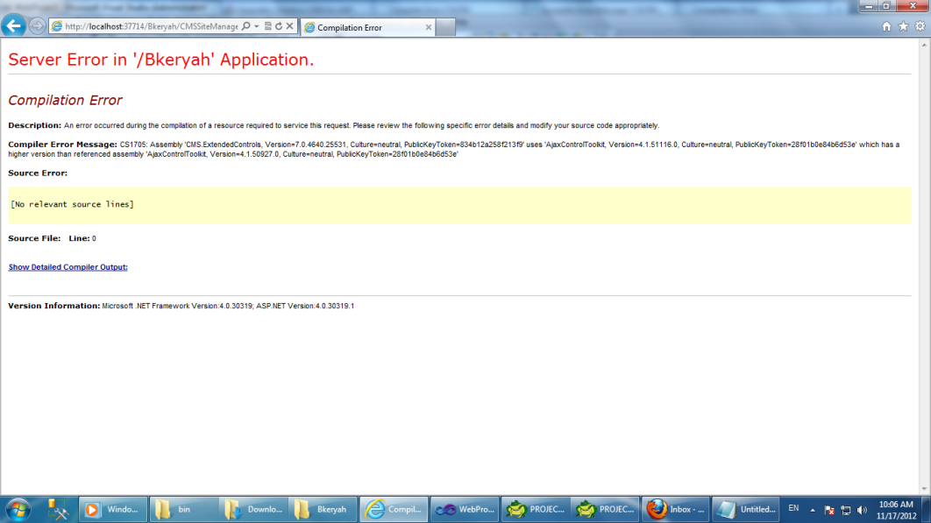
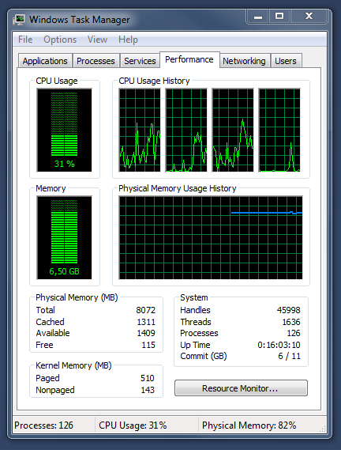
Did You Find Yourself In Situation Like This?
Exception after upgrade/hotfix
Solution?
Web site is slow
Server is not responding
We are losing clients/money
I don’t have enough time
How can I deliver more in less time?
There is always something to improve
Proper design
NOT affect/destroy the system
CONTEXT of implementation/customization
Efficient solution/work
Performance & Optimization
GET familiar with the system
TAKE advantage of built-in features/functionality
SIMPLIFY work of user & developer
NOTE: Performance mistakes webinar

Slide 3
Kentico Developer – Task Processing DIAGRAM
KENTICO RESOURCES
DEVELOPER
TASK
ANALYSIS
HOW? QUESTIONS
Documentation
KB
FAQ
Blog post
OPTIONS / IDEAS
Consulting
Support
CONTEXT
Forums
?
USE / DEPLOYMENT
TESTING
DEVELOPMENT

Slide 4
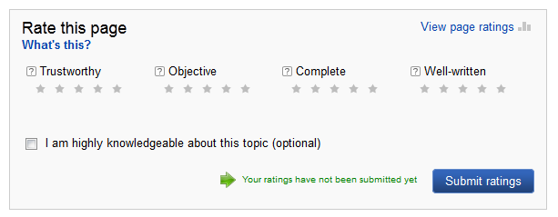
Development – Task Implementation
Document Content Rating
Kentico Options
Content Rating Module
On-line Forms Module
Custom Tables Module
DocumentCustomData (XML) column of Document
Combination (?) -> proper/efficient/optimized implementation? [DEPENDS]
Other Option(s)
Custom implementation / logic / code [requires extra time]
3rd party component(s)

Slide 5
Task Implementation [DEMO] (Content Rating)
Content Rating Module
Documentation – simple document rating,
CMS_Document table
DocumentRatingValue [Rating value]
DocumentRatings [Number of ratings]
Questions
DATA
Can I extend the CMS_Document (system) table using custom fields?
What is the deal with the “knowledgeable” checkbox?
I need content rating records per ‘user’ and ‘document’?
CODE
Can I extend the (built-in/system) ‘Content rating’ web part?

Slide 6
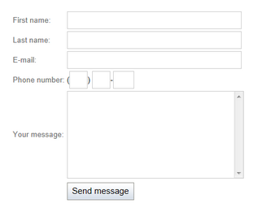
Task Implementation [DEMO] (Online Forms)
On-line Forms Module
Documentation - configured/customized forms
Implementation
DATA
ONE record on DB level per EACH submission
Each FORM CONTROL is represented as
separate COLUMN on DB level
HOW do I connect DOCUMENT and FORM?
CMS_Document
DocumentID vs. DocumentGUID
CODE
Built-in web part, form controls
HOW do I DISPLAY the RESULTS/RATING?
Repeater with custom query web part
Questions [CONTEXT CONSIDERATION]
Will this implementation work with documents of any type?
What about the multi-lingual web site feature? (‘en-us’ vs. ‘cs-cz’)
Will the data be synchronized with other environments? (import/export, staging)
Is this solution optimized?
Extendibility, Performance, Usability?
ONLINE FORM

Slide 7
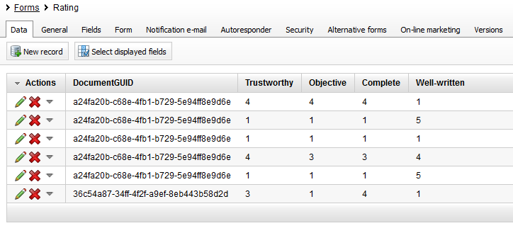
Task Implementation [DEMO] (Online Forms)
Questions [CONTEXT CONSIDERATION]
Performance?
Displaying/listing results/rating?
Cache the results
Optimize the SQL query / logic
1k users, 1k documents, 2 cultures
Customization possibilities for online forms?
Form handlers (OnBeforeSave etc.)
Kentico API
ONE record per ONE document (max.2k)
HOW?
NOTE: Form Engine webinar
ONLINE FORM DATA
RATING RESULTS

Slide 8
Task Implementation [DEMO] (Custom Tables)
Custom Tables Forms Module
Documentation - configured/customized tables
Implementation
DATA
< similar to On-line forms implementation >
CODE
< similar to On-line forms implementation >
NO built-in web part for generating form
CUSTOM available on Marketplace
NO e-mail notification
NO support for uploading files
Content staging synchronization
Questions [CONTEXT CONSIDERATION]
Will the data be synchronized with other environments? (import/export, staging)
Is this solution optimized?
Extendibility, Performance, Usability?
CUSTOM TABLE FORM

Slide 9
Task Implementation [DEMO] (DocumentCustomData)
DocumentCustomData (CMS_Document table)
Column for holding custom data (XML)
API: CustomData class
Best way of storing extra data on document level
Supported by
Import/Export
Content staging
Implementation
DATA
Data (XML) is stored in CMS_Document table
CODE
Form defined/generated by ‘custom table’
Submitted record is (NOT) saved?
HOW do I DISPLAY the RESULTS/RATING?
k# and TEXT/XML transformation
CurrentDocument.DocumentCustomData
Questions [CONTEXT CONSIDERATION]
Will the data be synchronized with other environments? (import/export, staging)
Is this solution optimized?
Extendibility, Performance, Usability?
NOTE: Think about - Logic (manageable by editors), Performance, Upgrade/Hotfix, other related modules
(e.g. content staging , import/export etc.)
CUSTOM TABLE FORM
DOCUMENT TABLE
<customdata>
<trustworthy>19</trustworthy>
<wellwritten>17</wellwritten>
<documentratings>5</documentratings>
<objective>10</objective>
<complete>13</complete>
</customdata>

Slide 10
Before Development
Requirements, Analysis & Design [Kentico Deliver NOW Methodology]
Am I "also" targeting mobile devices/development?
What is the structure of the web site?
What options do I have when migrating the existing web site into Kentico?
Product Road Map
Marketplace (web parts, web templates, integrations etc.)
Which development model to use (Portal Engine, ASPX, Mixed, MVC)
Environment setup (LIVE: shared hosting, dedicated, cloud [azure], web farm etc.)
Trust level (Full vs. Medium [Custom])
Where to keep files (Content Tree , Media library, Unmanaged, CDN, amazon s3, azure, etc.)
Type of a projects (web site, web application, windows azure)
Development for Azure
web site -> Azure SQL DB
blob storage (CDN) -> AZURE
web site to Azure project
web site -> MS SQL DB
blob storage (CDN) -> AZURE
SQL to SQL Azure
web site to Azure project

Slide 11
Development Environment (DEV)
Web Farm Synchronization, purpose? (Cache, Files[uploaded by UI, NOT web part files etc.])
A.) At the end of each request (default)
B.) Scheduled task [custom interval]
C.) Database updater (from 6.0.21) [interval 1s]
Developer A
Developer B
Developer A
Developer B
Source control
Server (TFS)
Source control
Server (TFS)
2.
1.
3.
1.
2.
DB
DB

Slide 12
Development - Page Processing
Page processing features
wireframing -> HTML
TEAM
object /document locking [check in/out] (document, page template)
object versioning (e.g.: CSS and transformations)
virtual objects on a FS under source control application (SVN etc.)
object cloning (form, custom table etc.)
use relative links with "~/" (Output filter – web site vs. web part level)
"fast" vs. "proper" design
layout web parts
editable region vs. layout HTML code
“preview“ mode
mobile development (device profiles, device layouts, device detection, etc.)
validation tools (HTML, CSS, Link checked, Accessibility)
SEO (settings, code [transformation])
NOTE: Define naming convention (web part, doc. type etc.)

Slide 13
Development
Think about
Backup of DB and PF on daily basis (site export is not valid backup)
Use separate user accounts, NOT ONE/SHARED user account!
Be aware when deleting objects/documents (recycle bin, check object assignment [page template])
Get familiar with project folder structure (where to keep custom files?)
Custom code - will it work in other environments?
Use "CMS.IO" for file system operations rather than "System.IO"
Pay attention to session (eliminate if possible)
Full vs. Medium trust
Disable caching!
Is the code optimized?
Pull the data at once
Data should be cached wherever it makes sense
Use built-in debugging tools (use other tools: SQL profiler, Memory profiler(s) etc.)
Take advantage of Kentico API (DO NOT use it blindly)
Check the “Event log", fix any issues
Pay attention to security
Test all possible scenarios
Do a load (performance) test before you go live

Slide 14
Customization, Migration, Integration
Customization options
Custom web part/widget, form control, payment gateway, etc.
Make a copy/clone of the existing one
Different life cycle ("User control" web part -> Telerik etc.)
Global event handlers (INSERT/UPDATE/DELETE etc. triggers for custom code)
Custom providers (way of changing the logic of built-in providers and their methods)
Others …
Migration options
Import toolkit (data from (MS SQL, XML, CSV, XLSX) as objects/documents
Kentico API (API Examples section)
CUSTOM SQL script / code
Integration options
REST (INSERT, UPDATE, DELETE)
Integration bus
Using Kenico API / controls outside of Kentico
Custom security handler
Custom scheduled task(s)
run in context of the web site or as windows service (better performance)
windows service: need to update references and rebuild the project (DLL)
web site context: no need to rebuild[*] (App_Code)
HOW TO integrate with ANOTHER system?
CRM
Connectivity?
Real-time?
One/Two way synch?

Slide 15
On-going Development
Deployment (DEV -> STG -> PRO)
staging, import/export (be EXTREMLY careful - you can overwrite anything)
DEV environment is using the SAME build/hotfix number as PRO
Backup of the PRO DB to DEV (get REAL DATA from PRO once in a time)
Bi-directional staging (PRO -> DEV)
Depending on the environment, you can also develop/test on the LIVE site (DEV -> PRO)
Create “Test” folder/section
exclude from navigation & smart search & listing web parts
disable OM activities on such pages
setup security if needed
use the naming convention in place, e.g. "Test_"

Slide 16
Upgrade & Hotfix
Facts
One major version per year [ service pack(s) ] - check ROADMAP
7-day hotfix policy
STOP web site when applying hotfix/upgrade
KIM (Kentico Installation Manager)
Download & apply hotfix/upgrade
READ the instructions and follow them to a T (AND verify ☺, e.g.: 3.1a -> 4.0)
CANNOT be applied over pre-compiled web site
HAVE backup of the web site (DB + PF)
TEST the hotfix/upgrade first in local environment, be PREPARED
How can I apply hotfix/upgrade on the LIVE site with minimal downtime?
DO NOT CUSTOMIZE system SQL queries, stored procedures, views, files etc.
Preparation for upgrade/hotfix starts during the design/development stage,
What can be changed with the Upgrade/Hotfix?
Can I customize built-in document type, system table (e.g. CMS_User) etc.?
What does the package contain?
SQL script (?)
Files (?)
new Kentico dll files with each hotfix/upgrade
provide custom code from App_Code

Slide 17
Upgrade & Hotfix
Upgrade
NOT cumulative (5.0 -> 5.5 -> 5.5R2 etc.)
Post-upgrade code executed first time application starts (+ import package)
Check NEW system requirements (SQL, .NET etc.)
You can APPLY it only ONCE
API CHANGES (custom files, transformations, k# code, web part layouts etc.)
DO NOT use obsolete methods
Hotfix
Latest hotfix package contains fix of all previous packages
The hotfix is not tested for all possible scenarios
NO NEED to apply frequently unless you run into some issues (bug)
Can be executed any number of times

Slide 18
Summary
GET familiar with Kentico
Project folder structure
Customization options
API
DO NOT MODIFY system related objects (FS, DB)
ANALYZE & CONSULT the solution
Consider the CONTEXT & ENVIRONMENT
Take advantage of BUILT-IN functionality / features
as much as possible
TEST & OPTIMIZE the design
Kentico
Consulting Services
Ad-hoc Consulting
Performance & Health Audit
Upgrade Audit
Upgrade Protection Plan
Solution Upgrade

Slide 19
Contact
Miro Remias
e-mail: miro@kentico.com
consulting: http://www.kentico.com/Support/Consulting/Overview

