Slide 1
K# And Kentico EMS – Part 2
Karol Jarkovsky
Consulting Services Manager
Kentico Software
http://devnet.kentico.com/blogs/karolj.aspx
karolj@kentico.com

Slide 2
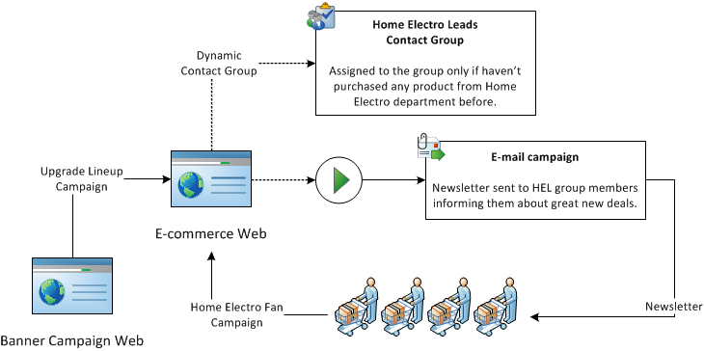
Sample Scenario

Slide 3
Demo
DEMO

Slide 4
Campaigns
Cookie named Campaign in the user's browser containing the name of the campaign,
Only one campaign at a time,
Cookie value overwritten if the user returns to the site through a different campaign,
Cookie duration is 24 hours,
All actions (conversions) performed by the visitor with active campaign are logged campaign actions,
Active campaign is also recorded for On-line Marketing Activities.

Slide 5
Contact Groups
Contact group used to separate contacts matching certain criteria and the rest,
One contact can be member of multiple contact groups,
Contact group can be subscribed to a newsletter,
Contacts assigned to the group manually or dynamically when matching specified condition,
Besides standard context information the current contact info available as well

Slide 6
E-mail Campaign
E‑mails sent out via Kentico Newsletters module,
Support for multiple SMTP servers – load balanced SMTP environment ensuring reliable delivery of millions of e-mails within reasonable time,
Subscribers management manually or via subscription web parts on the live site,
With the Kentico EMS and On-line Marketing suite you can also use contacts or segmentation/dynamic contact groups,
Up to date list of contacts that are willing to consume information you want to share - everything is managed automatically for you,
E-mail activity tracking – opened e-mails, click-through, bounced e-mails,
Information available in macro selectors within the Newsletter module :
NewsletterIssue,
Newsletter,
Subscriber,
Email, FirstName, LastName, UnsubscribeLink,

Slide 7
Content Personalization
Allows you to define personalized content based on context in which pages are viewed,
You can easily display or hide certain elements on page based on current user information or any other system/site variable (e.g. e-commerce orders, current month total sale, etc.),
Personalization done through the web part zones, web parts or widgets (only those in the page editor zones),
Personalized variants are displayed when variant condition is matched,
When a visitor accesses page on the live site appropriate variant will be displayed for each object.

Slide 8
Questions & Answers
?

Slide 9
Thank you!

