Slide 1
E-commerce customization
12/19/2011 Petr Vozak, Technical Leader

Slide 2
E-commerce customization: Agenda
General customization
Database table API
Customization model
Customization examples
Calculation customization
Calculation model
Customization examples

Slide 3
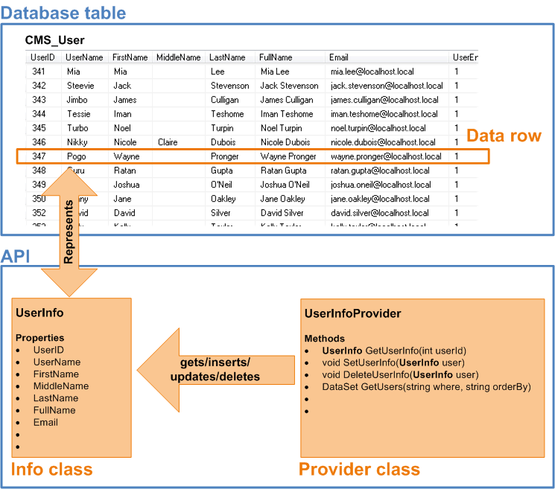
Database table API

Slide 4
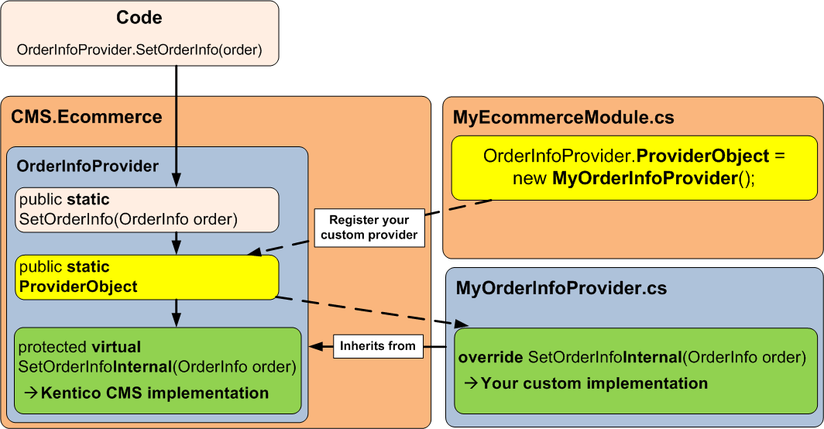
E-commerce customization model

Slide 5
E-commerce customization examples
Add starting credit to each new customer
→ override CustomerInfoProvider.SetCustomerInfoInternal
Add specific amount of credit to each customer after he makes an order
→ override OrderInfoProvider.SetOrderInfoInternal

Slide 6
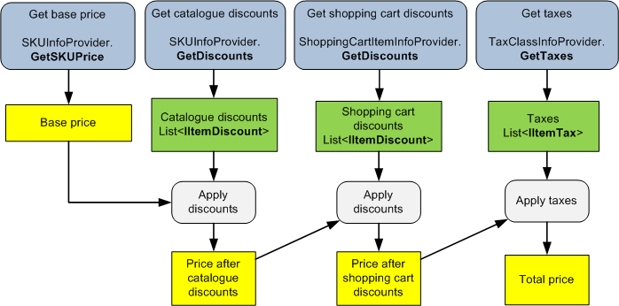
Shopping cart calculation model + examples

Slide 7
Other shopping cart customization examples
Custom shipping calculation
→ override ShippingOptionInfoProvider.CalculateShippingInternal
Add product A to the shopping cart -> product B is also added (automatically)
→ override ShoppingCartInfoProvider. AddShoppingCartItemInternal

Slide 8
E-commerce customization
Questions ?

Slide 9
Sources
E-commerce customization model blog post
http://devnet.kentico.com/Blogs/Petr-Vozak/October-2011/E-commerce-6--New-customization-model.aspx
Customization model in version 5.5R2 and older
Customization model in version 6
Upgrade instructions from 5.5R2 to 6
API examples user interface
http://devnet.kentico.com/docs/devguide/api_examples_user_interface.htm

Slide 10
Contact
Petr Vozak
e-mail: petr.vozak@kentico.com
blog: http://devnet.kentico.com/Blogs/Petr-Vozak.aspx

