Slide 1
Development and Production Environment Setup with Kentico CMS
Karol Jarkovsky
Consultant
Kentico Software
http://devnet.kentico.com/Blogs/Karol-Jarkovsky.aspx
karolj@kentico.com

Slide 2
Agenda
How to:
Development Roles
Team Development
Setup DEV and QA environment
Setup PROD environment
Migrating changes
Questions & Answers

Slide 3
1. Development Roles
Roles typically involved in the process of development:
Role | Minimum Technical Expertise | Description | Required for Content Publishing
Content Editor | Word Processing, Web Browsing | Creates the Web content, determines what content is published, where it will be published and when it will be published | Yes
.NET Developer | ASP.NET | Maintains/extends and modifies WCMS application code | No
Designer | CSS, HTML, FLASH, Silverlight | Maintains/extends or modifies visual design elements | No
Database Manager | SQL Administration | Maintains/manages WCMS repository | No

Slide 4
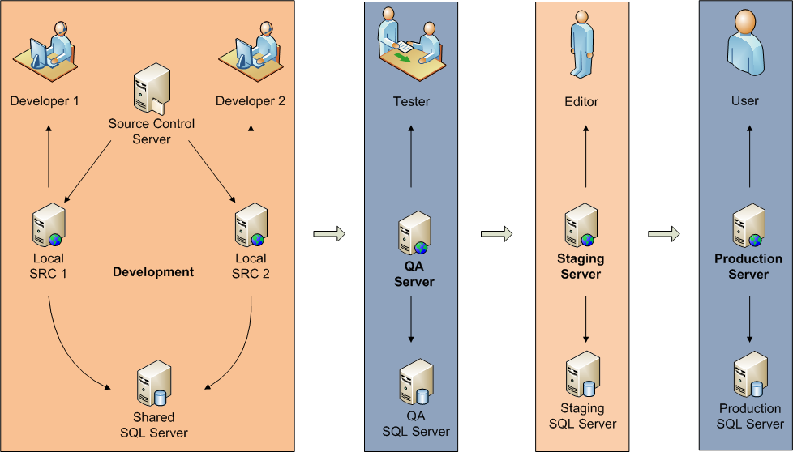
2. Team Development

Slide 5
3. Setup DEV and QA environment
Developers are running a local copy of the web project under the Source Control (SC),
Modified files are checked-out/ checked-in by developers in SC preventing unintended override,
All developers share the single database, specified through the web.config stored by SC,
Changes made to the object storing its metadata in the DB are reflected for all developers,
Web farm synchronization used for notifying all the DEV machines when changes require cache to be flushed,
QA responsible for verifying that changes achieve the desired functionality and quality,
No development and content authoring is done in QA,

Slide 6
4. Setup PROD environment
Staging
Once changes pass the QA phase, they are deployed to this stage from the DEV environment (using the same set of data used for QA),
Content is created in this stage by editors and synchronized with the production,
Certain web development tasks may take place in this stage; later also pushed to the production,
Production
Ideally used only by the live site users,
All the content and code changes should be done in this stage and synchronized afterwards,

Slide 7
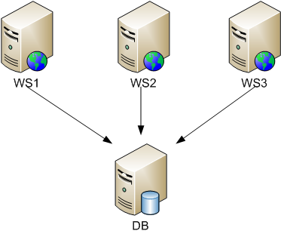
4. Setup PROD environment
Web farm support
Each web server running its own copy of the code files
Using Web farm support to synchronize changes influencing cached content and physical files
- Connected to the single database
Notes:
In some cases PROD environment is used directly by EDITORs to add new or manage existing content,
In that case WORKFLOW should definitely be used,

Slide 8
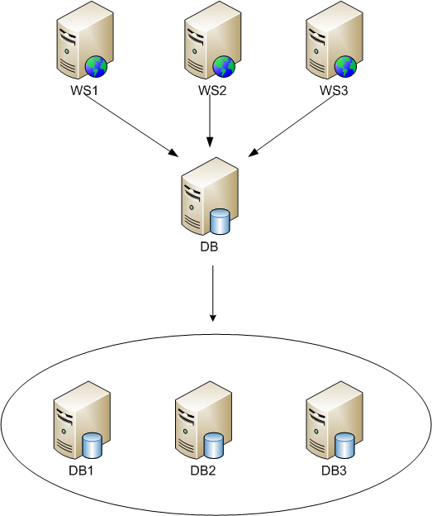
4. Setup PROD environment
Clustered database
Database cluster exposed as a single node
Each web server connected to the same DB point
Getting a boost on SQL level
Web farm support enabled
Notes:
In some cases PROD environment is used directly by EDITORs to add new or manage existing content,
In that case WORKFLOW should definitely be used,

Slide 9
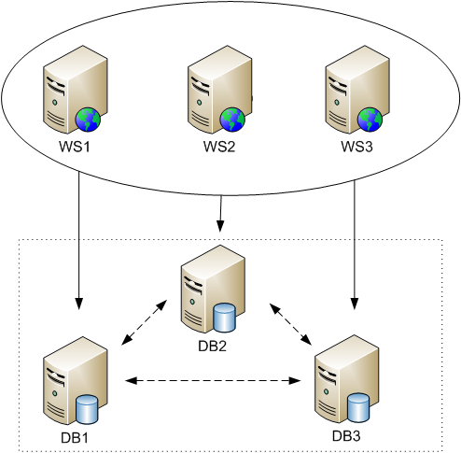
4. Setup PROD environment
SQL replication
Multiple database servers with SQL replication enabled
Each web server connected to a dedicated database server
Web farm support enabled
Notes:
In some cases PROD environment is used directly by EDITORs to add new or manage existing content,
In that case WORFKLOW should definitely be used,

Slide 10
5. Migrating changes
Using Export and Import functionality
+ Export of all system objects in the form of a single ZIP package, including all object related physical files,
+ Based on the location of your custom files (code files, script files, images, etc.) within the web project folder, they are exported along with the website or even when the export of global objects is performed,
+ No theoretical limit on maximum package size (suitable for large files),
+ Incremental deployment,
- Access to the web server (web project folder) required,
- Need to manipulate with the export package (copy over, run import wizard),

Slide 11
5. Migrating changes
Using Content staging module
+ Best fit for synchronizing content changes in general,
+ Synchronization is just a matter of a single click, done completely from the CMS Desk UI, no need to access the web server file system,
+ Possibility to choose items to synchronize one-by-one,
+ Incremental deployment,
- Does not support synchronization of some objects (e.g. web part code files, BizForms data, forum posts, ACLs (document permissions, etc.),
- Maximum size limit for the file being synchronized (determined by maximum request length
for HTTP POST),

Slide 12
5. Migrating changes
Manually deploying backup files (web project + database)
+ Creates an exact copy of the environment on the target machine,
+ There is no limitation on the size of objects at all,
+ No stepping through the wizard or manually selecting tasks to synchronize,
- Access to the database required (to create the backup file),
- No way to easily select only particular objects to export,
- No incremental deployment

Slide 13
6. Questions & Answers
?

Slide 14
Thank you!

