Slide 1

Transformations Revealed
Karol Jarkovsky
Consulting Services Manager
Kentico Software
http://devnet.kentico.com/blogs/karolj.aspx
karolj@kentico.com
Notes:
Good morning everyone!
My name is Karol Jarkovsky, I’m Sr. Solution Architect for Kentico and I’ll be your host for this month’s Partner Webinar. I’m happy to be here with you and I’m really excited about the topic we’re going to discuss today.
We’re going to talk about transformations and I strongly believe that most of you already used transformations before, is that correct? Actually, if you used Kentico I’m like 100% positive you touched the transformation at some point.
So let’s take a look at what is the motivation to learn about transformation, why it is so important…

Slide 2

Why Transformations Again?
FACT Transformations are Alpha and Omega of content presentation
FACT Kentico 5.5 R2 offers 2 transformation types (ASCX and XSLT) → Kentico 6.0 offers 5 types (ASCX, XSLT, Text/XML, HTML, jQuery)
FACT Each type provides different performance in rendering HTML output on the server- side,
GOAL Understand transformation types, what are pros and cons of each type and when it makes sense to use one type over another.
NOTE If you are not familiar with concept of transformations please
refer Transformations section in Kentico Developer’s Guide.
Notes:
FACT Transformations are Alpha and Omega of content presentation
Transformation really is very basic element of the content presentation. It transforms raw data retrieved from the Kentico CMS database into whatever form you wish it to appear in on the Live site. It’s therefore crucial to understand what options you have, what are advantages or disadvantages of different transformation types available in the system and when it makes sense to use one type over another,
FACT Kentico 5.5 R2 offers 2 transformation types (ASCX and XSLT) - Kentico 6.0 offers 5 types (ASCX, XSLT, Text/XML, HTML, jQuery)
While with versions prior to the Kentico CMS 6.0 there were basically two transformation types available, such as ASCX transformation and XSLT transformation with the current version there are 3 new transformation types available so we’re looking at 5 types in total. There is obviously reason why we introduced these additional types and so I’d like to share that information with you today as well,
FACT Each type provides different performance in rendering HTML output on the server-side
Believe it or not, each transformation type has specific performance characteristics. Recently our Consulting Group is working on many Performance & Health Audit projects where we push the boundaries of client projects in terms of performance and scalability of the solution. Especially with higher traffic websites even apparently small decision like selecting the right transformation can have huge impact on the system at the end,
GOAL Understand transformation types, what are pros and cons of each type and when it makes sense to use one type over another
Our goal therefore is to understand characteristics of each transformation type available in the system, be clear about advantages and disadvantages of every one of them to be able to decide when to prioritize one type before another.
NOTE If you are not familiar with concept of transformations please refer Transformations section in Kentico Developer’s Guide
Please note that we aren’t going to cover much about how to write transformations, how you manage them and other essentials. I’m assuming that you know these basics. If you are not familiar with transformations please read through the related Developer’s Guide section. The link is included in the presentation that you can download after we publish recoding of this webinar on Kentico Devnet portal.

Slide 3
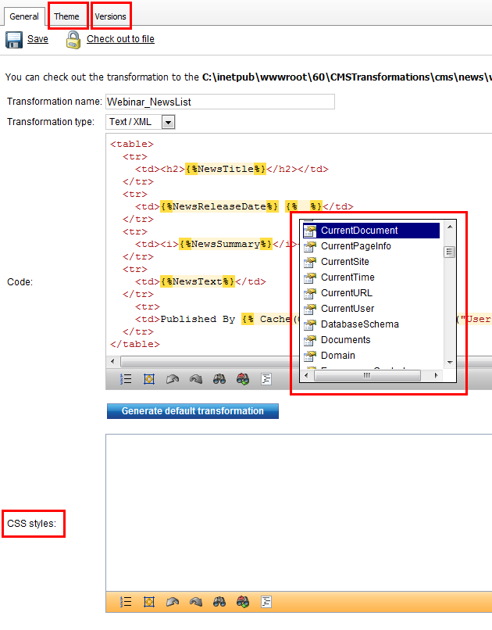
What’s New in 6.0?
Transformation types
  ASCX < 6.0
  XSLT < 6.0
  Text/XML NEW
  HTML NEW
  jQuery NEW
Transformation specific CSS styles
  More on CSS for page components
The Theme tab
  More on App themes
Object versioning
  More on Object versioning
Macro expressions + K# + Intellisense
  More on Macro expressions
Notes:
Let’s quickly cover improvements done in transformations field for the current version of K[ay] CMS:
Transformation types
As I mentioned earlier only ASCX and XSLT transformations were available in the versions prior to release of Kentico CMS 6.0. With the current version we have introduced another 3 types – Text/XML, HTML and jQuery transformations. We’ll cover each type in a minute here.
Transformation specific CSS styles
One of the great enhancements to 6.0 version is definitely support for component CSS styles. For those of you not familiar with this new feature I recommend to look into Developer’s Guide following the link on the slide. What component CSS allows you to do is to define CSS styles bound to component only (in this case by component we understand transformation). The advantage is these styles are managed alongside transformation itself instead of global CSS style sheet, they’re exported along with the component only and are included on the page and transferred to the client only in the case that transformation is used on the page. Thus it’s considered improvement performance-wise and from manageability point of view.
The Theme tab
Another improvement in management of the transformation-related design elements is ability to manage content of App_Themes folder from the transformations UI. You can manage the content of sub-folder located in the App_Themes folder where system stores any transformation related files you upload on the Theme tab. You can reference these files in the transformation code or/and transformation CSS. Best part is theme folder content is exported along with the transformation, so you do not need to worry about files missing because you’d forget to export them manually.
Object versioning
Object versioning support allows you create new version on the transformation as you go, so you have option to roll-back to some of the previous versions in case you need to.
Macro Engine + K# + Intellisense
The last improvement I want to mention are features added to the transformation editor. With the current version you can take advantage of new Macro Engine and K# scripting language AND for certain transformation types (like Text/XML, XSLT or jQuery) you can also leverage capabilities of built-in Intellisense empowering your complex macro expressions.
Let’s review available transformation types one by one next…

Slide 4
ASCX Transformations
PROS
  Supports ASCX markup language, inline code and nested controls,
    DelayedLoading, StopProcessing properties to sync nested control’s life cycle,
  Provides access to the parent webpart properties,
<%# GetDataControlValue("WebPartTitle") %>
  Custom functions implemented as static methods and called from transformations using full name.
CONS
  Missing user-friendly macro expression support, no Intellisense, macros resolved using
<%# CMSContext.CurrentUser.UserName %>
  <%# CMSContext.CurrentResolver.ResolveMacros("{%CMSContext.CurrentUser.UserName%}") %>
  ASCX transformation = virtual control = requires Virtual Path Provider
    to load and compile transformation on the fly = CPU + RAM overhead
  Application restarting caused by exceeding number of
  re-compiles

Slide 5
XSLT Transformations
PROS
  XSLT = eXtensible Stylesheet Language Transformation,
  Data source-agnostic = can be used with any data source serialized to XML,
  XSLT only manipulates the source tree = original XML source is left unchanged,
    Filter/sort data on-the-fly = data retrieved just once,
    No SQL query with updated WHERE/ORDER BY executed to filter/sort (unlike other web parts do),
    Great when sharing the same data with other controls (re-using the content),
  Using XSL-FO = eXtensible Stylesheet Language – Formatting Objects = one can apply different flow to objects on the page creating adaptable design,
  User-friendly macro expressions support + Intellisense, NO compilation & VPP = no additional overhead,
  NOTE: XSLT attributes are case sensitive!
CONS
  Doesn’t allow nested controls, inline code,
  Doesn’t use standard ASCX markup,
Notes:
The XSLT is a high-level declarative, transforming and formatting language.
First, data retrieved from source needs to be serialized into XML. In Kentico you can use XSLT Viewer web part, serializing DataSet with documents matching specified criteria into XML You can of course develop custom Kentico data source web part serializing any source type (e.g. PDF document, TXT document, JSON response, etc.) into XML and connect it to the XSLT viewer afterwards.
The XML source data are converted by compiler into a source tree structure which is composed of various types of nodes. Final transformation is accomplished with XSLT by using pattern matching and templates. Patterns are matched against the source tree while templates are used to create a result tree. Please note Kentico only invoke transformation process, XSLT template binding is done by .NET FW itself.
Note that XSLT only manipulates the source tree and that the original XML source is left unchanged. As all templating is done on-the-fly and source data are unchanged you can re-use them multiple times. The most important aspect of XSLT is that it allows you to perform extremely complex manipulations (like data filtering and sorting) while the final output bear no resemblance to the source document. Also, unlike with standard data source or repeater web parts there is no need to execute another SQL query with changed WHERE/ORDER BY every time I want to filter/sort data.

Slide 6
Text/XML & HTML Transformations
PROS
  Transformation code processed as standard HTML/XML,
    HTML transformations editable using WYSIWYG editor = HTML produced by editor,
  Updatable even when the VPP is not running in the target environment (medium trust OR pre-compiled website) = faster render time,
  User-friendly macro expressions support + Intellisense, NO compilation necessary = no additional overhead,
  The ApplyTransformation() macro function works with Text/XML transformations,
    Used to display content of objects retrieved through the macro expression as part of
CONS
  Doesn’t allow nested controls, inline code,
  Doesn’t use standard ASCX markup,

Slide 7
jQuery Transformations
PROS
  Less data transferred between server and client,
    Only template text + raw data are sent to the client,
  Binding performed on the client = overhead moved from application server to client,
  Updatable even when the VPP is not running in the target environment (medium trust OR pre-compiled website) = faster render time,
  User-friendly macro expressions support + Intellisense, NO compilation necessary = no additional overhead,
CONS
  Slightly more effort involved in setting up jQuery templates,
    Need to implement jQuery call to retrieve source data from (e.g. using REST service to get content from CMS in JSON format),
  Doesn’t allow nested controls, inline code,
  Doesn’t use standard ASCX markup.
Notes:
jQuery transformation is actually template with HTML markup and binding expressions. This template is then applied to the array of objects and rendered into the HTML DOM. Template binding happens in the client browser not on the server which means you’re also saving application server resources by passing part of the load on the client machine.
The most important is that using jQuery templates you can reduce total amount of data transferred between application/server and client which helps freeing some bandwidth and at the same time increase latency of your application. That’s why jQuery templates are heavily used in mobile environment. Instead of refreshing the whole page or sending larger fragments of HTML code (as that would be the case with AJAX or asynchronous callbacks) you can transfer only raw data from server and bind them on client using jQuery templates. With this approach you are going to be making fewer calls and moving less data to the client at the end. Hope you see it in there.

Slide 8
Hierarchical Transformations
Nested repeaters vs. Universal Viewer (using Hierarchical Transformation)
  Nested repeater executes SELECT query for every parent document,
  Universal Viewer executes single SELECT query for each document type,
    Single SELECT per doc type no matter how many parent documents are being displayed,
Regular viewer (e.g. repeater) vs. Universal Viewer (Hierarchical Transformation) when displaying multiple doc types
  Standard viewer does not persists content hierarchy from the content tree = each document type loaded as a separate DataTable within resulting DataSet,
Web parts supporting Hierarchical Transformations
  New alternative to nested repeaters,
  Allows you display multiple document types by single viewer web part,
  You can apply different transformation based on document type and nested level
    You can display documents of the same document type in multiple ways based on their position in the content tree.

Slide 9
What’s new in 7.0?
Transformation preview,
Intellisense inside transformation editor displaying document/object properties based on the current context,
Support for nested objects in the Eval() function
Eval("SKU.SKUManufacturer.ManufacturerDisplayName")

Slide 10
Questions & Answers
?

Slide 11
Thank you!
Notes:
Thank you for joining me today, hope you found this topic at least as interesting as I do. I wish you have great rest of the day and see you again next time!
Thank you!

