Slide 1
Real World Examples – Part II
7/26/2013 Miro Remias, Sr. Solution Architect

Slide 2
WWW – World Wide WAIT
My web site is slow. How can I improve the performance?
DISABLE FEATURES
OPTIMIZE CUSTOM CODE
GET BETTER HW
SETUP CACHING
MOVE TO CLOUD
REDESIGN THE IMPLEMENTATION

Slide 3
Agenda
SCENARIO I: Handling redirects in Kentico
URL management
IIS vs. Application & Performance
SCENARIO II: Cookie-less domain(s)
SCENARIO III: Implementing CDN in Kentico
Pull vs. Push CDN type
Custom Storage Provider vs. Output filter

Slide 4
SCENARIO I

Slide 5
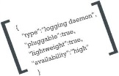
Handling redirects in Kentico - I
Performance of redirect on application level
Browser
I WANT this page (/MyCampaign)
Web server(s)
IIS
Your page is somewhere else (/Home)
2
I WANT this page (/Home)
Kentico
Visitor(s)
1
Here is HTML code of /Home page
Solution(s)?
Don’t use redirect
What is the SEO impact of having duplicate content?
Solution? CANONICAL links
Redirect sooner, on IIS?
URL Rewrite module
What if I have hundreds / thousands of URL aliases?
WE NEED URL management!
DB
1
2

Slide 6
Handling redirects in Kentico - II
URL Rewrite module – Kentico as URL management tool
Web server(s)
IIS
(*)
3
Rewrite rule Rewrite MAP
Kentico
CUTOM scheduled task (**)
2
Editor(s)
A.) Static URL (/MyCampaign)
Redirect (301 vs. 302)
DO NOT redirect
SEO: canonical link
MVC or .NET ROUTE
B.) Wildcard URL (/MyDeailPage/{id})
Redirect (301 vs. 302)
DO NOT redirect
SEO: canonical link
MVC or .NET ROUTE
DB
Custom table (***)
Document Alias
1
(*) - Any change to rewrite rule file or rewrite map requires application restart to take affect.
(**) - Can be replaced with global event handler(s), but does not make much sense because of (*).
(***) - Suitable in cases you have list of OLD URLs or migrating existing web site to Kentico.

Slide 7
Question?
What about
https redirects?
domain redirects?
extension redirects?
letter case redirects?

Slide 8
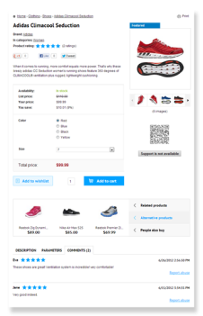
Handling redirects in Kentico - III
NO REDIRECT – CANONICAL LINK(s) – SEO (*)
/MyHome
Web server(s)
IIS
Browser
Rewrite rule Rewrite MAP
Visitor(s)
/MyHome
Kentico
1
Current URL (/MyHome) is alias of main URL (/Home)
CL: /Home
(*) - According to Google, the canonical link element is not considered to be a directive, but a hint that the web crawler will "honor strongly“, but search engine prefers the use of 301 redirects – they can choose to ignore a canonical link.

Slide 9
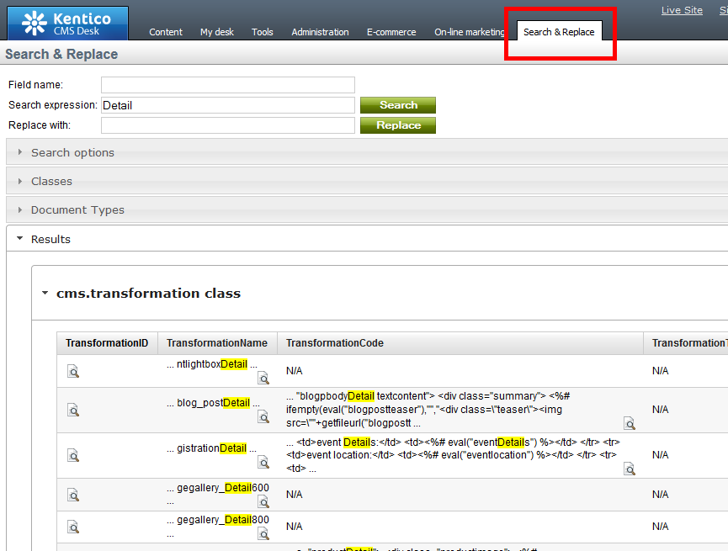
Handling redirects in Kentico - EXTRA
WHAT about replacing hard-coded LINKs / URLs?
CUSTOM SEARCH & REPLACE MODULE

Slide 10
SCENARIO II

Slide 11
Cookie-less domain - I

Slide 12
Cookie-less domain - II
RENDERING static resources with CUSTOM cookie-less DOMAIN
Web server(s)
dmn.com/Home
IIS
Browser
Rewrite rule Rewrite MAP
Kentico
Visitor(s)
Output Filter
+?
2
HTML+
HTML
static?.dmn.com/img1
static?.dmn.com/img2
static?.dmn.com/img3
DB
Custom table
1

Slide 13
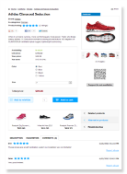
Cookie-less domain - III
SETTING cookies to NULL for static domain
Web server(s)
IIS
Browser
static.dmn.com/img1
(*)
. . .
Rewrite rule Rewrite MAP
HTML+
static.dmn.com/img1
Kentico
CUTOM scheduled task (*)
Visitor(s)
RESPONSE HANDLER
1
Client cache
RESOURCE
2
DB
Custom table
(*) - Rule to redirect user from static domain (e.g. static.domain.com) to main domain in case .NET resources are requested (default.aspx).

Slide 14
SCENARIO III

Slide 15
Implementing CDN in Kentico - I
NOTE: Average web page contains around 50 resources!

Slide 16
Implementing CDN in Kentico - II
CDN Types
PUSH
AMAZON S3
WINDOWS AZURE
CUSTOM STORAGE PROVIDER ?
(ORIGIN) PULL
HOW to?

Slide 17
Implementing CDN in Kentico – III
Kentico
dmn.com/Products
Browser
1
Visitor(s)
. . .
HTML+
cdn.dmn.com/img1
cdn.dmn.com/img2
cdn.dmn.com/img3
CACHE
(ORIGIN) PULL CDN

Slide 18
The NEXT scenario?
Share your story with us …
consulting@kentico.com

Slide 19
Contact
Miro Remias
E-mail: miro@kentico.com
C Consulting: http://www.kentico.com/Support/Consulting/Overview

