Slide 1
Go…Running Kentico CMS on Windows Azure
Thomas Robbins, Chief Evangelist, Kentico CMS
Notes:
Harnessing the content beast – Content marketing in the multiscreen world
Desktops, mobile phones, massive flat screens, TV’s, tablets, netbooks, mini-tablets… the list of devices your customers are using to consume your content keeps growing! Unfortunately, this doesn’t match your marketing budget. When it comes to serving content in today’s world it’s a myriad of screen sizes and effective calls to action. What are your choices? The landscape of consumerism has changed in a few short years allowing our customers more choices for reading, watching, communicating, socializing, shopping, and making purchase decisions. In this webinar we will look at the core concept and practical strategies for making effective and responsive content in the multi-screen world we live in. We will also look at possible frameworks available and how best to integrate this approach with your marketing plan.
Attending this session you will learn:
Practical strategies to determine the appropriate screen sizes for your content marketing materials.
Building effective calls to action for multiple screens.
Practical strategies to use when building your content marketing plan in today’s multi-screen world.
Decision strategies for deploying content effectively.

Slide 2
Azure Kentico Virtual Conference Agenda
Time | Session Information | Register
7:00 –8:00 AM PST 10:00-11:00 AM EST 3:00-4:00 PM BST | Are you ready? Introduction to Cloud Computing and Windows Azure Speaker: Vince Mayfield, CEO Bit-Wizards | Register me
Break
8:30-9:30 AM PST 11:30–12:30 PM EST 4:30-5:30 PM BST | Get set.. Introduction to Windows Azure Development Speaker: Brian McKeiver, Kentico MVP and Partner/Senior Developer at BizStream | Register me
Break
10:00–11:00 AM PST 1:00 –2:00 PM EST 6:00–7:00 PM BST | Go…Running Kentico CMS on Windows Azure Speaker: Thom Robbins, Chief Evangelist Kentico CMS | Register me
Break
11:30–12:30 PM PST 2:30–3:30 PM EST 7:30 –8:30 PM BST | Deployment options for Kentico CMS on Windows Azure Speaker: Bryan Soltis, Kentico MVP and Director of Technology and Research at Bit-Wizards | Register me
Break
1:00 PM–2:00 PM PST 4:00–5:00 PM EST 9:00–10:00 PM BST | Best Practices for Kentico CMS and Windows Azure Speaker: Dominik Pinter, Group Product Manager/SaaS and Cloud | Register me
Break
2:30–3:30 PM PST 5:30–6:30 PM EST 10:30–11:30 PM BST | Advanced development with Windows Azure Speaker: Bryan Soltis, Kentico MVP and Director of Technology and Research at Bit-Wizards | Register me
Break
4:00–5:00 PM PST 7:00–8:00 PM EST 12:00–1:00 AM BST | Common questions for Windows Azure and Kentico CMS Speaker: Kentico Cloud and SaaS Development Group | Register me

Slide 3
Agenda
Understand the local Azure and Kentico CMS development environment
Install Kentico CMS on your development machine (Windows Azure project)
Look at the Azure Emulator
Get going quickly with Kentico+

Slide 4
Azure Architecture 101
AppFabric cache
ASP.NET Web role
SQL Azure
Smart search worker role
AppFabric cache

Slide 5
CMS.IO namespace is your friend
System.IO
Kentico CMS business layer
CMS.IO
Azure blob API
…
The CMS.IO namespace is an intermediary between the Kentico CMS business layer and various file storage. On a standard Windows installation, CMS.IO only overrides the System.IO namespace. On Windows Azure the namespace uses a provider which works with the blog storage, creating an imitation of the Windows file system
CMS.IO namespace can be extended to support other types of storage like the Amazon Cloud Drive.

Slide 6
Are you ready?
Make sure you can answer yes to all of these before starting
Do you have the Azure SDK/Emulator installed?
Do you have a SQL Azure server/ database available?
Cloud deployment requirements
Do you have at least a Small Compute Instance size available?
Do you have an Azure storage account?
Do you have the AppFabric Caching Service (128mb or more)?

Slide 7
Installation Overview (development machine)
Setup (kenticocms.exe) – installs the basic files required to create the project
Web installer-used to create the new project designed for Azure deployment
Application structure and configuration – once installed you can run it locally on the Azure emulator and configure for preferences
Database setup – when run the first time starts database installation creating required tables and scripts

Slide 8
Windows Azure SDK 2.0
Web Sites: Visual Studio Tooling updates for Publishing, Management, and for Diagnostics
Cloud Services: Support for new high memory VM sizes, Faster Cloud Service publishing & Visual Studio Tooling for configuring and viewing diagnostics data
Storage: Storage Client 2.0 is now included in new projects & Visual Studio Server Explorer now supports working with Storage Tables
Service Bus: Updated client library with message pump programming model support, support for browsing messages, and auto-deleting idle messaging entities
PowerShell Automation: Updated support for PowerShell 3.0, and lots of new PowerShell commands for automating Web Sites, Cloud Services, VMs and more

Slide 9
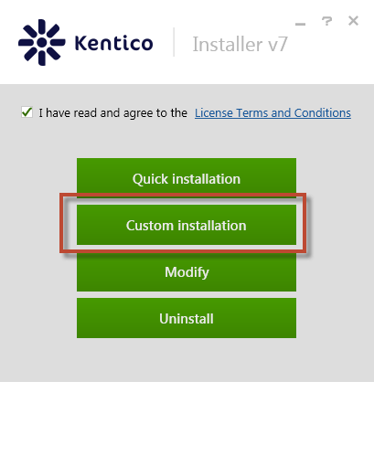
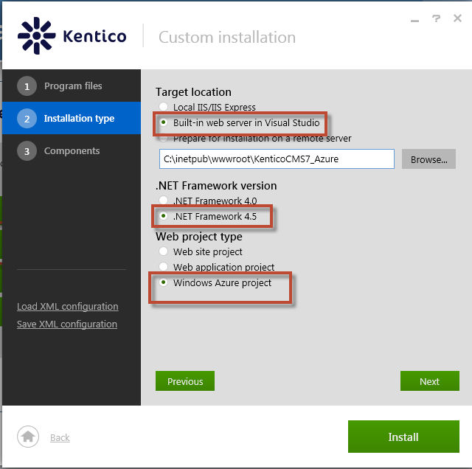
Installation

Slide 10
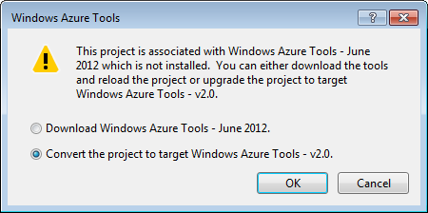
Open the project
If the project was created with a Windows Azure Tools release before 1.6 (November 2011), the project is automatically upgraded to the current version.
If the project was created with the November 2011 release and that release is still installed, the project opens in that release.
Microsoft reference available here

Slide 11
What happens when I upgrade
The web.config file for web roles and the app.config file for worker roles are updated to reference the newer version of Microsoft.WindowsAzure.Diagnostics.DiagnosticMonitoirTraceListener.dll.
The Microsoft.WindowsAzure.StorageClient.dll, Microsoft.WindowsAzure.Diagnostics.dll, and Microsoft.WindowsAzure.ServiceRuntime.dll assemblies are upgraded to the new versions.
Publish profiles that were stored in the Azure project file (.ccproj) are moved to a separate file, with the extension .azurePubXml, in the Publish subdirectory.
Some properties in the publish profile are updated to support new and changed features. AllowUpgrade is replaced by DeploymentReplacementMethod because you can update a deployed cloud service simultaneously or incrementally.
The property UseIISExpressByDefault is added and set to false so that the web server that’s used for debugging won’t automatically change from Internet Information Services (IIS) to IIS Express. IIS Express is the default web server for projects that are created with the newer releases of the tools.
If Windows Azure Caching is hosted in one or more of your project’s roles, some properties in the service configuration (.cscfg file) and service definition (.csdef file) are changed when a project is upgraded.
If the project uses the Windows Azure Caching NuGet package, the project is upgraded to the most recent version of the package. You should open the web.config file and verify that the client configuration was maintained properly during the upgrade process. If you added the references to Windows Azure Caching client assemblies without using the NuGet package, these assemblies won't be updated; you must manually update these references to the new versions. For more information about how to upgrade projects that use Windows Azure Caching, including instructions for verifying your web.config files.

Slide 12
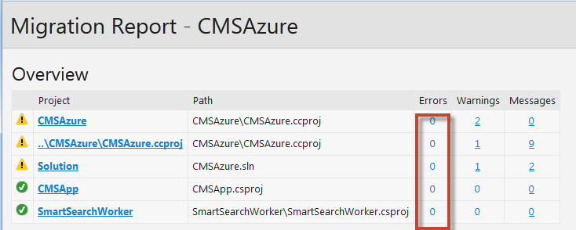
Warnings are OK
If you get errors please contact support@kentico.com

Slide 13
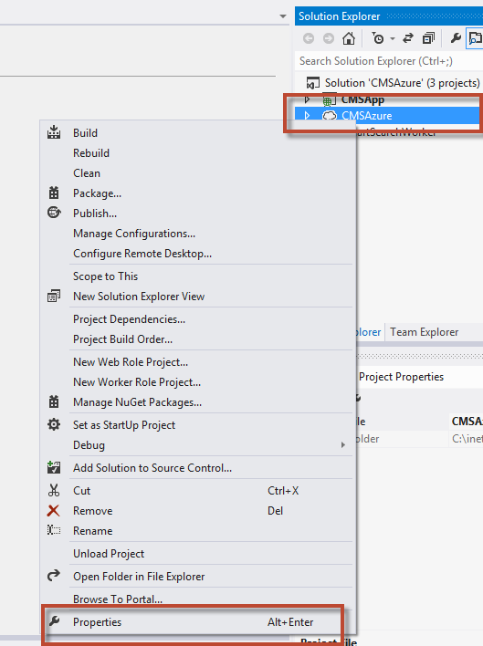
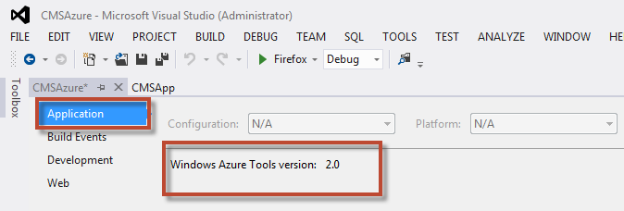
Determine the SDK Version
1. In the project right click and select Properties
2. In the Properties window select the Application tab to view the SDK version

Slide 14
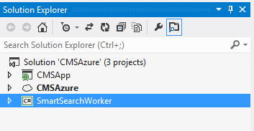
Application Structure
CMSApp is Kentico CMS in the web application format
CMSAzure uses the Windows Azure project template and is necessary to ensure that the application can be deployed as a hosted service on Windows Azure. It contains the service definition and service configuration files
SmartSearchWorker is used to carry out tasks required by the Smart Search module

Slide 15
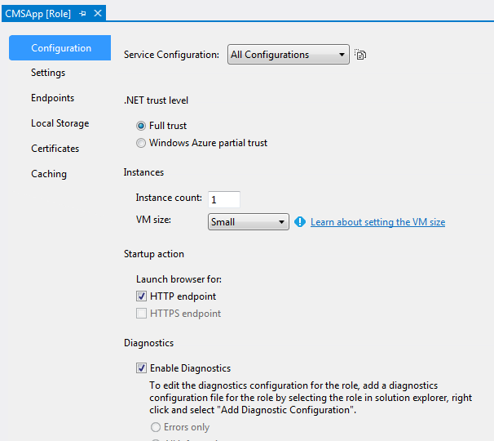
Roles

Slide 16
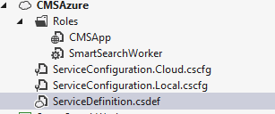
Other important areas
The ServiceConfiguration.cscfg file sets values for the configuration settings defined in the service definition file and specifies the number of instances to run for each role. This file can be updated while your service is running in Windows Azure.
The ServiceDefinition.csdef file contains the metadata that is required by the Windows Azure environment for the requirements of your application, including what roles it contains. This file also contains configuration settings that apply to all instances. These configuration settings can be read at runtime using the Windows Azure Service Hosting Runtime API. This file cannot be updated while your service is running in Windows Azure.

Slide 17
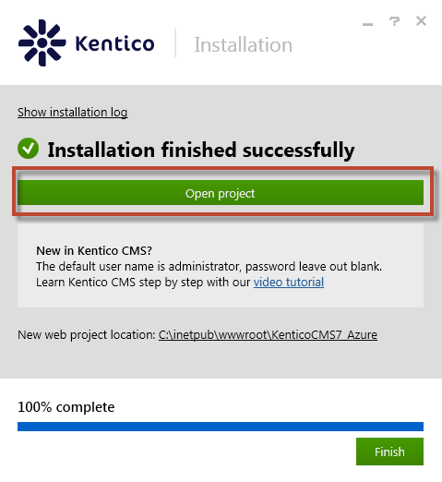
Finish the installation

Slide 18
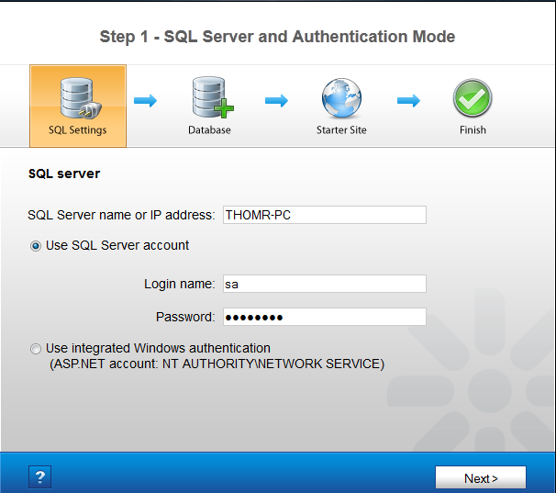
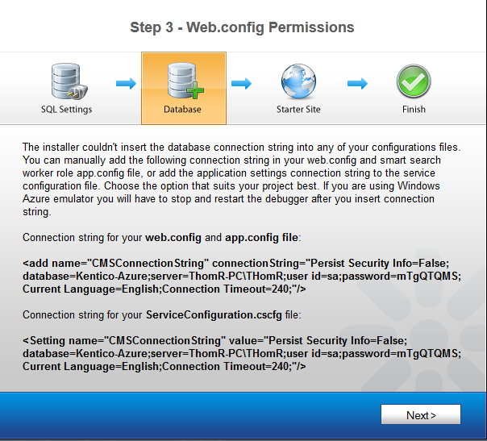
Database setup
Web.config

Slide 19
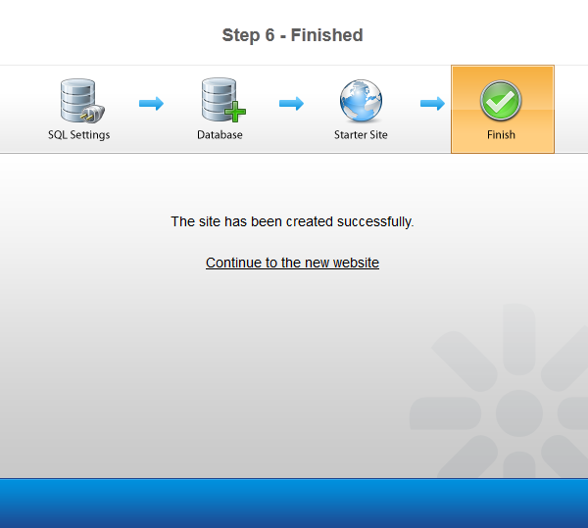
Ready to go!

Slide 20
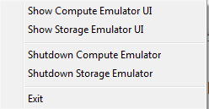
The Azure emulator
The Windows Azure compute emulator is a tool that locally emulates the environment that cloud services run. Used to build and test your application before deploying it to Windows Azure.
The Windows Azure storage emulator provides a local environment that emulates the Windows Azure Blob, Queue, and Table services for development purposes. Using the storage emulator, you can test your application against the storage services locally, without incurring any cost.

Slide 21
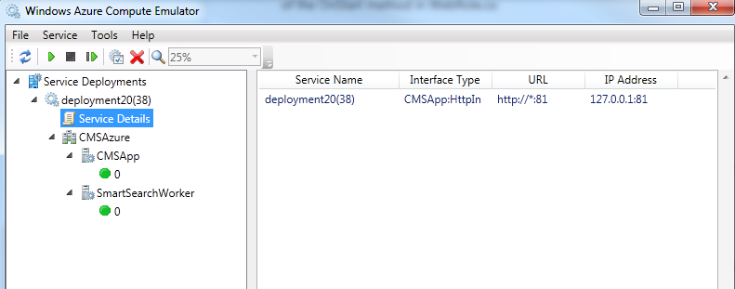
Compute Emulator
More information here
General differences:
Local roles can access the Local Assembly Cache
Logging information is captured by Windows Azure diagnostic and visible
Local compute emulator runs with Administrator privileges
Local compute instance doesn’t emulate load balancing
Local compute deployment limited to 50 role instances

Slide 22
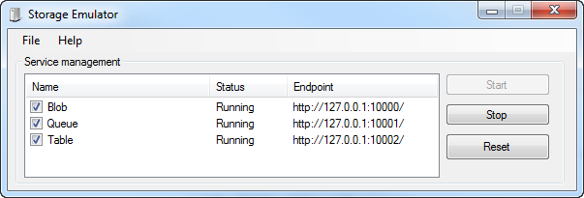
Storage emulator
More information here
General differences:
Supports only a single fixed account and a well known authentication key (Not secure)
Account name: devstoreaccount1
Account key: Eby8vdM02xNOcqFlqUwJPLlmEtlCDXJ1OUzFT50uSRZ6IFsuFq2UVErCz4I6tq/K1SZFPTOtr/KBHBeksoGMGw==
Not scalable or intended for a large number of concurrent clients
The URI scheme supported by the storage emulator differs from the URI scheme supported by the cloud storage services. The development URI scheme specifies the account name as part of the hierarchical path of the URI, rather than as part of the domain name. This difference is due to the fact that domain name resolution is available in the cloud but not on the local computer.

Slide 23
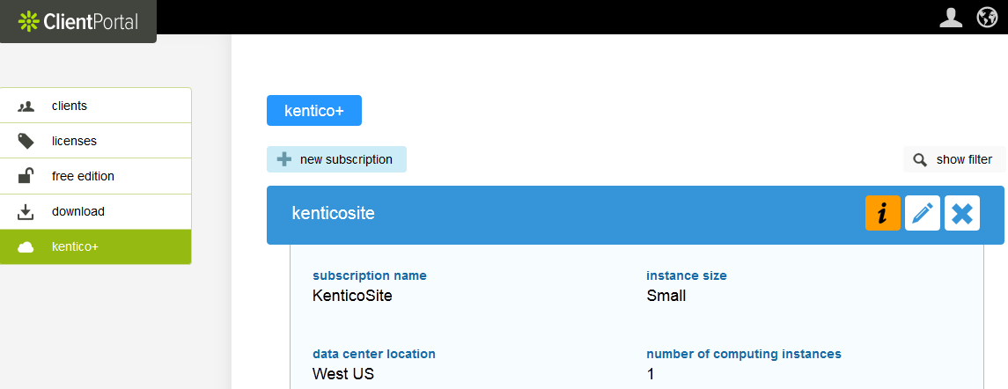
A little detour – Kentico+

Slide 24
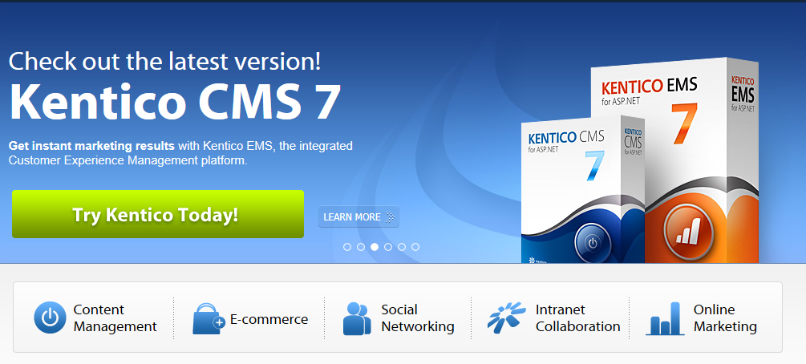
Thanks! Still more to come!
Thomas Robbins
Chief Evangelist, Kentico CMS
@trobbins
thomasr@kentico.com

Slide 25
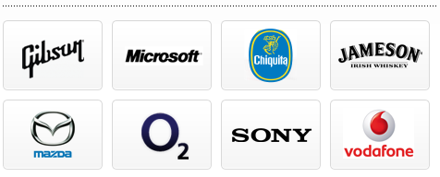
Who are we?
Kentico CMS is one of the most powerful Customer Experience Management Systems and Content Management Systems on the planet. With over 16,000 web sites in 90 countries and backed by over 1,200 partners. it is used for everything from simple web sites to complex applications.
Kentico CMS is easy to install, simple to manage and reliable.

