Slide 1
Real World Examples – Part I
5/24/2013 Miro Remias, Sr. Solution Architect

Slide 2
Agenda
SCENARIO I: ‘Training’ program
CMS vs. EMS
SCENARIO II: jQuery Repeater
HOW TO improve user experience and performance

Slide 3
SCENARIO I

Slide 4
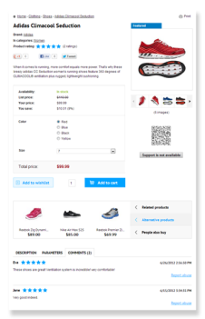
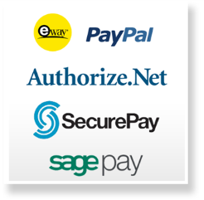
‘Training’ program - subscription mechanism
Buyer(s)
Product
Payment provider(s)
Configuration
Kentico
Materials
Processor
Is the order PAID?

Slide 5
Let’s prepare the “food” …
What to cook?
Training’ program subscription mechanism
What do we need?
- tools (WHERE?)
Kentico CMS or EMS
- ingredients (WHAT?)
Kentico built-in FEATURES
- recipe (HOW?)
Depends on tools and ingredients

Slide 6
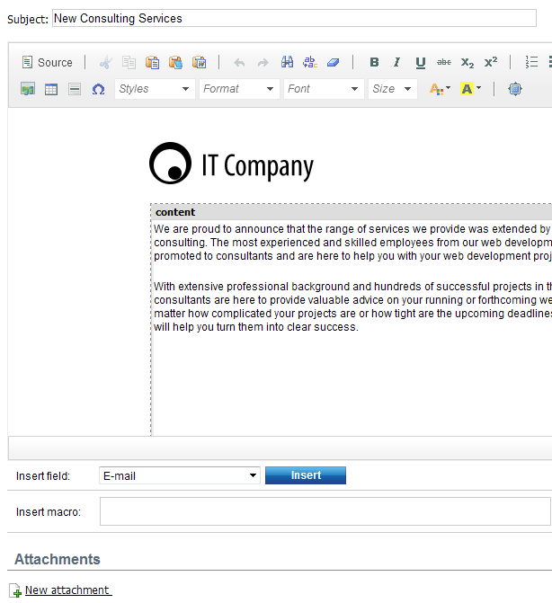
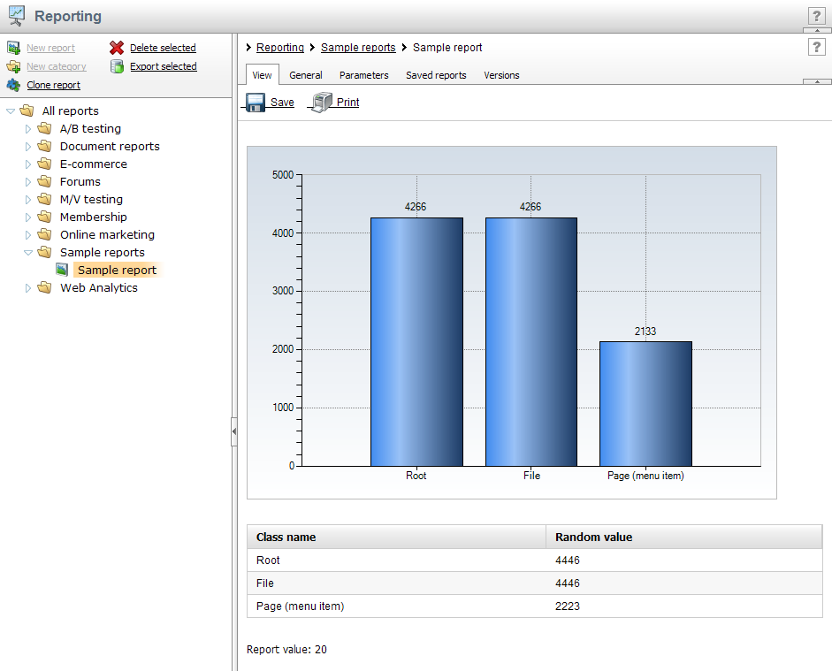
Let’s prepare the “food” - Ingredients
INGREDIENTS with CMS
Newsletter module
Reporting module
E-commerce solution
Custom tables module
Scheduled task

Slide 7
NEWSLETTER Module
E-MAIL sending TIMELINE
t
WHAT we need?
t

Slide 8
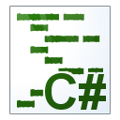
Let’s prepare the “food” – Recipe with CMS
Buyer(s)
Product A, B, C …
1
Payment provider(s)
Custom table
Newsletter A, B, C …
3
Subscriber
Kentico
Queue processor
4
2
CUTOM scheduled task
Is the order PAID?
- E-commerce providers
E-mail queue
5
Administrator
Report

Slide 9
Let’s prepare the “food” – CMS RESULT
Implementation
custom scheduled task code,
Training program e-mail sending automation,
custom e-commerce provider code,
Is order paid?
custom report SQL query,
How many subscriber do we have?
configuration: custom table, newsletters, products
Usability & Extendibility
Separate configuration table holding info when the newsletter issue e-mail should be sent,
User could introduce LOGICAL issue very easily,
Further customization ONLY with custom code,
Performance
Depends on
scheduled task execution interval,
How often we would like to run the whole process?
where the scheduled task is running (as external vs. site context),
Use separate thread
scheduled task code,
Optimize the code to load most of the data from SQL at once or in bulks,
number of subscribers and number of different ‘training’ products,
Always perform a load test!

Slide 10
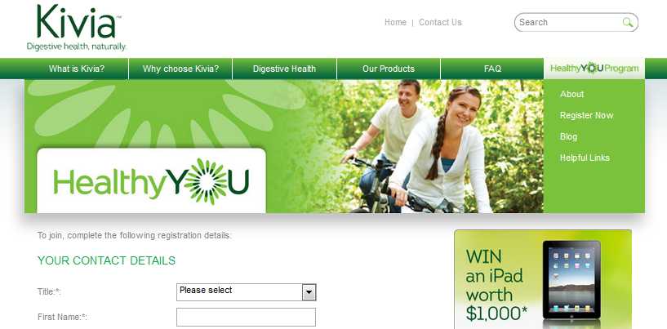
Let’s prepare the “food” – LIVE EXAMPLE
Live implementation - kivia.com.au
Implemented by Forefront Digital
“The Kivia web site was for the Australian launch of a natural Kiwi fruit supplement to assist with Digestive Health. A key feature of the site is the Healthy You section that automatically emails subscribers support materials over a 22 week period including email based polls to identify their continuing use of the product.”

Slide 11
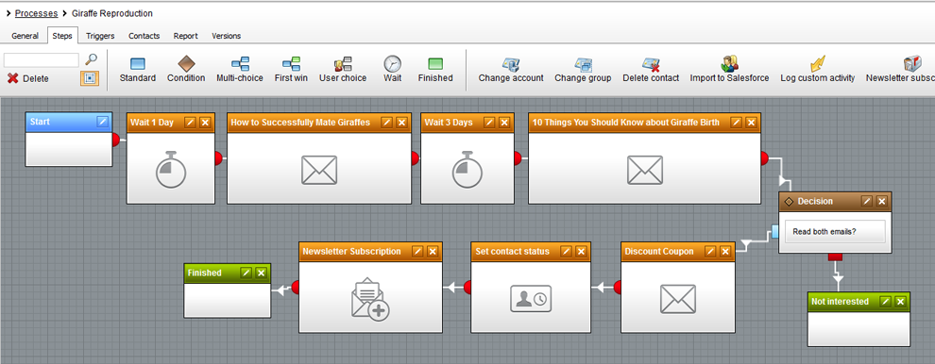
Let’s prepare the “food” - Ingredients
INGREDIENTS with EMS
E-commerce solution
Newsletter module
Online Marketing & Marketing Automation

Slide 12
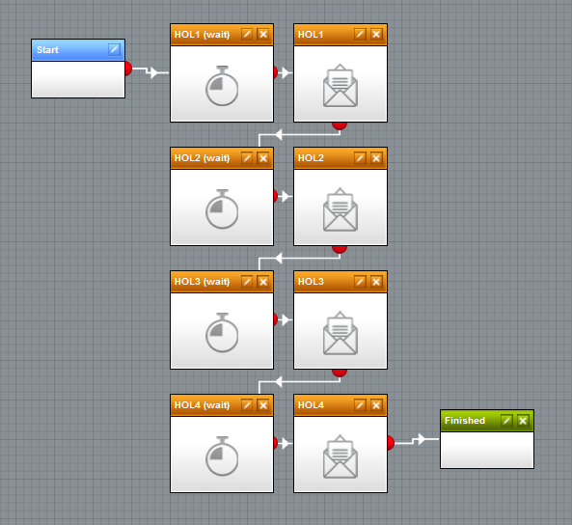
Let’s prepare the “food” – Recipe with EMS
Buyer(s) / contact(s)
Product A, B, C …
Payment provider(s)
Marketing Automation
Trigger
Kentico
Is the order PAID?
- ACTIVITY PERFORMED
Administrator / Marketer

Slide 13
Let’s prepare the “food” – EMS RESULT
Implementation
configuration: marketing automation process, newsletters, products
NOTE: Custom code in ‘special’ scenarios.
Usability & Extendibility
Easy to re-design / change the whole automation process with visual editor,
Performance
Depends on
number of subscribers and number of different ‘training’ products,
New ‘system’ scheduled task for each ‘wait’ / ‘timeout’ step,
Executed at a given time (deleted if applicable),

Slide 14
SCENARIO II

Slide 15
jQuery Repeater
main IDEAS
Improve user experience and decrease waiting time,
Off load some of the server side processing and communication
Use resources of client’s machine to render the retrieved data,
Prevent transferring unnecessary overhead data that is present with each HTTP request / response,
Transfer less data (preferably DATA in ROW format)

Slide 16
jQuery Repeater – COMMON scenario(s) with PAGING
I WANT this page
Here is your page
Visitor(s)
page resources?
JS, CSS, IMAGE etc.
I WANT this page (=2)
A)
Here is your page (=2)
page resources?
JS, CSS, IMAGE etc.
Kentico
B)
I WANT to refresh only some part of HTML
Here is your partial HTML
C)
I WANT to get some RAW data (XML, Json etc.)
Here is your RAW data

Slide 17
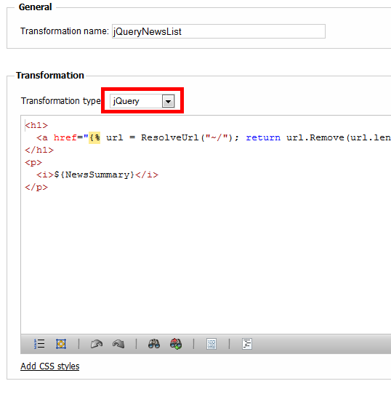
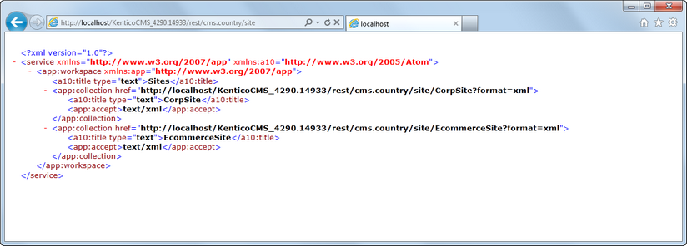
jQuery Repeater – WHAT DO WE NEED?
jQuery library
jQuery transformation
REST service
Kentico API
NOTE: This version of jQuery repeater works only with documents, not objects.

Slide 18
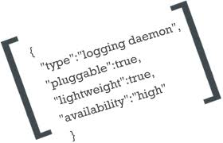
jQuery Repeater – Implementation (HOW?)
Visitor(s)
HTML code (CUSTOM WEB PART)
jQuery library
jQuery ajax call method (REST service URL)
jQuery template / transformation
Kentico
jQuery AJAX: I want ROW data (JSON) for pages 1-5
JSON response
REST service
jQuery AJAX: I want ROW data (JSON) for pages 6-10
JSON response
REST service

Slide 19
jQuery Repeater – ISSUES?
What if the JavaScript is disabled
nothing is listed on a page
MODIFICATION: You can render the first PAGE on server.
Internet crawlers / bots can not handle JavaScript
page is indexed as partially empty,
MODIFICATION : USE content personalization and define two versions of your repeater,
CurrentDevice.IsCrawler

Slide 20
The NEXT scenario?
Share your story with us …
consulting@kentico.com

Slide 21
Contact
Miro Remias
E-mail: miro@kentico.com
C Consulting: http://www.kentico.com/Support/Consulting/Overview

