Slide 1
Built-in Kentico CMS UI Controls
Part II - UniSelector
Karol Jarkovsky
Sr. Solution Architect
Kentico Software
http://devnet.kentico.com/Blogs/Karol-Jarkovsky.aspx
karolj@kentico.com

Slide 2
Agenda
Overview
Hierarchy
Members
Custom filter development
Q & A

Slide 3
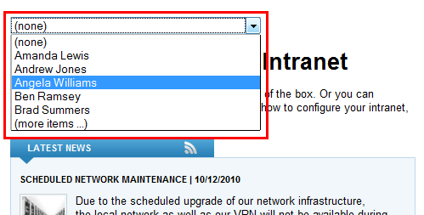
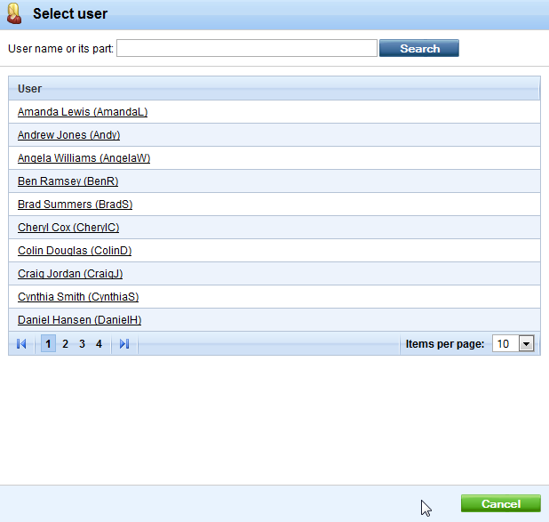
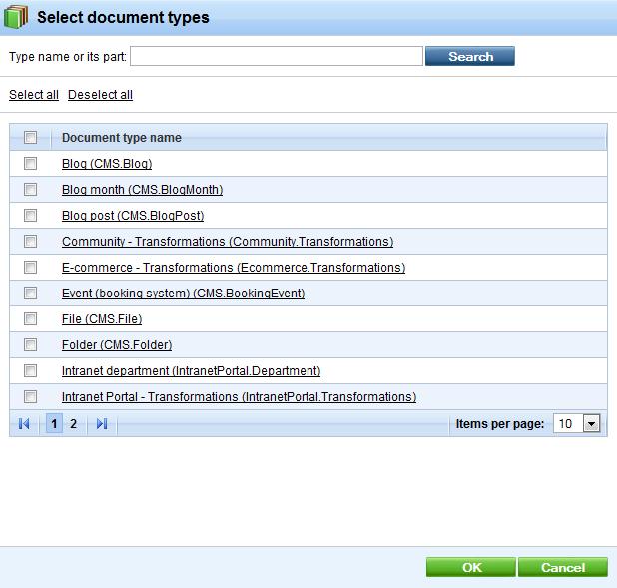
Overview
In Kentico CMS UI used to make a selection from a list of objects:
Add roles, Add users, Add child types, etc.

Slide 4
Hierarchy
UniSelector.ascx control located in ~/CMSAdminControls/UI/UniSelector/
cms:UniGrid / asp:TextBox / cms:LocalizedButton / asp:DropDownList
Selection dialog
Grid XML Def
OnItemsSelected
ObjectType
OnSelectionChanged
Filter

Slide 5
Members
Name | Description
AdditionalColumns | Names of columns that should be loaded with the objects of the specified data class.
AllowAll | If set ‘(all)’ is displayed as option in the drop-down list in the SingleDropDownList SelectionMode.
AllowEditTextBox | Indicates whether the value of the TextBox displayed in the SingleTextBox or the MultipleTextBox SelectionMode can be manually edited.
AllowEmpty | If enabled, the ‘(none)’ value is available in the SingleDropDownList SelectionMode and the Clear button is displayed in SingleTextBox and MultipleTextBox mode. When an empty value is used, the Value of the control is 0 or an empty string.
NoneRecordValue | Value returned when the ‘(none)’ item is selected in SingleDropDownList SelectionMode.

Slide 6
Members
Name | Description
AllRecordValue | Contains the value used when the ‘(all)’ item is selected in SingleDropDownList SelectionMode. The default value is -1.
ButtonImage | If specified, the selection button is displayed as a LinkButton using this image if the SelectionMode is SingleButton or MultipleButton.
DialogWindowHeight/Width/Name | Used to set default height and width of modal selection dialog. You can assign unique name to the modal dialog in case multiple selectors are used on the same page.

Slide 7
Members
Name | Description
DisplayNameFormat | Used to modify display format of items in the selection dialog list. Macro expressions in format {%ColumnName%} must be used here. The columns required by the used macros are loaded automatically as long as they belong to the table accessed by executed query.
EditItemPageUrl | If URL specified an edit button that links to the specified URL is displayed. Only available for SingleTextBox and SingleDropDownList SelectionMode.
EditWindowName | Used to specify unique name of the modal edit dialog.
EnabledColumnName | If set to column that is of BOOL type assigns DropDownItemDisabled CSS class to specific options. Works with SingleDropDownList SelectionMode.

Slide 8
Members
Name | Description
FilterControl | Path to the filter control (inheriting from CMSAbstractBaseFilterControl class). It will be used for custom filtering of items displayed in the modal selection dialog.
GridName | Path to the XML configuration file of the UniGrid control used to display and select objects in Multiple SelectionMode.
IconPath | Path to icon displayed in the title of modal selection dialog.
ItemsPerPage | Used to set the maximum amount of displayed selected items per page in Multiple SelectionMode.
LocalizeItems | When enabled localization macros are resolved in the modal selection dialog.

Slide 9
Members
Name | Description
MaxDisplayedItems | Maximum number of objects displayed by the drop-down list in SingleDropDownList SelectionMode. Default value is 25.
NewItemPageUrl | Can be used to specify the URL of a custom page that handles the creation of new objects. If a value is entered, a new button that links to the specified URL is displayed. Only available for SingleTextBox SelectionMode.
ObjectType | Specifies the data class of the objects to be selected using object class name (e.g. ‘cms.user’, ‘cms.role’, etc.)
OrderBy | Contains the ORDERBY clause used to determine the order of objects. It also affects the order in the modal selection dialog.
RemoveConfirmation | Used to specify the text displayed in the confirmation message when removing items from list. Entering an empty string disables the confirmation message.

Slide 10
Members
Name | Description
ResourcePrefix | Prefix used in the full names of resource strings (keys) containing the labels of the various interface elements displayed by the UniSelector. This can be used to assign custom strings to the control. Used format is <res prefix>.<string name> String names: additems - text caption of the add items button used to open the selection window in Multiple mode, all - name of the list item representing the selection of all available objects in SingleDropDownList mode, clear - text caption of the clear button used in TextBox modes, edit - text caption of the edit button used in SingleTextBox and SingleDropDownList mode,

Slide 11
Members
Name | Description
 | empty - name of the list item representing an empty selection in SingleDropDownList mode, itemname - header text of the column containing the names of objects in the selection window and the UniGrid displaying selected objects in Multiple mode, moreitems - name of the list item that opens the selection window if the maximum amount of list items is exceeded in SingleDropDownList mode, new - text caption of the new button used in SingleTextBox mode, newitem - name of the list item that opens the new item page in SingleDropDownList mode, nodata - text message displayed in Multiple mode if no objects are selected and the ZeroRowsText property is not defined, pleaseselectitem - text of the JavaScript alert displayed when the edit button is used when no object is selected,

Slide 12
Members
Name | Description
 | removeall - text caption of the button used to deselect all objects in Multiple mode, removeselected - text caption of the button used to deselect the specified objects in Multiple mode, select - text caption of the select button used to open the selection window in TextBox and Button modes, selectitem - text of the labels associated with the action elements used by the UniSelector; this is also used to set the title of the selection window
ReturnColumnName | Name of the column used for the values of selected objects. If empty, the object ID column is used. The column must be a unique identifier for the given object type.

Slide 13
Members
Name | Description
SelectionMode | The following modes are available: SingleTextBox - button that allows the selection of one object and a TextBox displaying the selected value, MultipleTextBox - button that allows the selection of multiple objects and a TextBox displaying the selected values, SingleDropDownList - displays a drop‑down list containing objects. If necessary, the selection window can be opened by selecting ‘(more items ...)’ from the list, Multiple - consists of a UniGrid control displaying the selected objects and buttons to add or remove them, SingleButton - button that allows the selection of one object, MultipleButton - button that allows the selection of multiple objects

Slide 14
Members
Name | Description
SpecialFields | Used to specify two dimensional string array that contains custom items to be displayed in SingleDropDownList SelectionMode. The first value is the name of the item, the second represents the value of that item when it is selected.
UseDefaultNameFilter | Indicates whether the default name filter should be used in the selection dialog. Default filter is using DisplayNameColumn information of info object.
Value | Used to get or set the selected value of the control. Return column specified by the ReturnColumnName property.
ValuesSeparator | The character used to separate selected values in the case of multiple selection. A semicolon (" ; ") is used by default.

Slide 15
Members
Name | Description
WhereCondition | You can explicitly filter out items from the list of objects available for selection.
ZeroRowsText | Can be used to specify the text displayed when no objects are selected in Multiple SelectionMode.

Slide 16
Members
Event | Description
OnItemsSelected | Occurs when an object or objects are selected in SingleButton and MultipleButton Selection Mode. This event is not raised in other modes.
OnSelectionChanged | Fired when the set of selected objects is changed. The event is not raised in SingleButton or MultipleButton SelectionMode. This event is usually used to perform tasks with selected objects in Multiple mode without the need for a confirmation button.

Slide 17
Custom filter development
Create custom ASCX control with all server controls you need,
Let the control inherit from CMSAbstractBaseFilterControl,
Override WhereCondition property of the base class,
Implement generating WHERE condition in this property- UniSelector will access this value before selection dialog loads content,
Set FilterControl property for UniSelector to point to your custom filter ASCX

Slide 18
Questions
?

Slide 19
Thank you!

