Slide 1
Kentico CMS 5.5 R2
What’s New

Slide 2
Highlights
Intranet Solution
Document management package
WebDAV support
Project & task management
Document libraries
Windows Azure support
Workgroups
MS Sharepoint 2010 support
“Versioning without workflow”

Slide 3
MS Sharepoint 2010
MS Sharepoint web parts support connection to MOSS 2007 and MOSS 2010
Available in all editions

Slide 4
“Versioning without workflow”
Documents are always in the Published step under this workflow type
It’s not possible to add any custom steps
Supports check-in/check-out and version history
Used by Document libraries

Slide 5
WebDAV support
Enables direct editing of files on the live site
The file is opened by a client application and saved back directly, without the need to create a local copy
E.g. MS Office files are directly editable in MS Office 2003+

Slide 6
Workgroups
Focused on team collaboration and co-operation
Can be created and managed directly by end users
Workgroup members may invite other users to join the workgroup

Slide 7
Workgroups
Workgroup includes following modules:
Project management
Message boards
Forums
Wikis
Polls
Media libraries

Slide 8
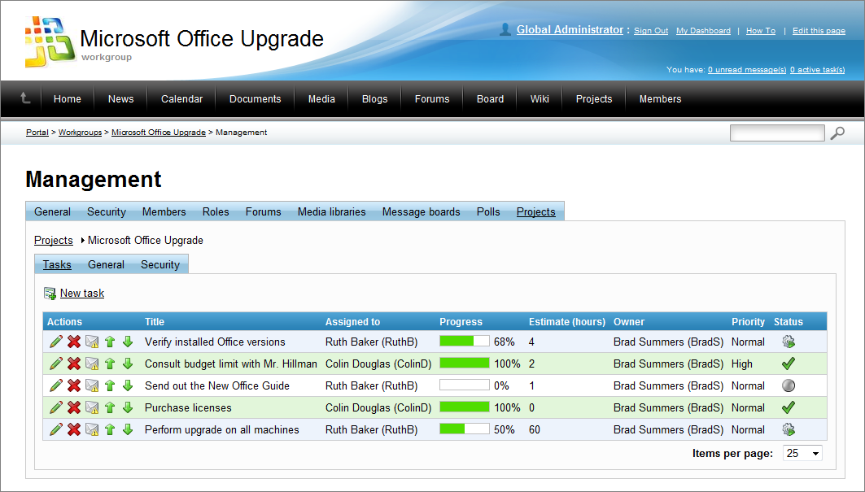
Workgroups

Slide 9
Document library

Slide 10
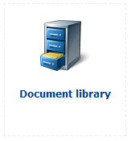
Overview
Management of any CMS.File in the content tree
Based on the Document library web part
Integration with WebDAV
Workflow support
Check-in/check-out support
Copy/Delete/Open/Edit of any file
Permissions management per document library and per each file
Version history
Document archiving

Slide 11
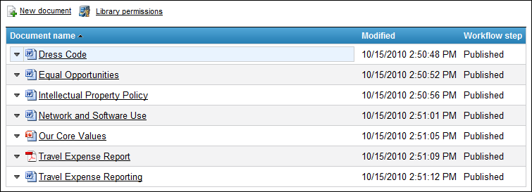
Live site
All features available on the live site
Files are represented as a table
All used layouts and forms are fully customizable

Slide 12
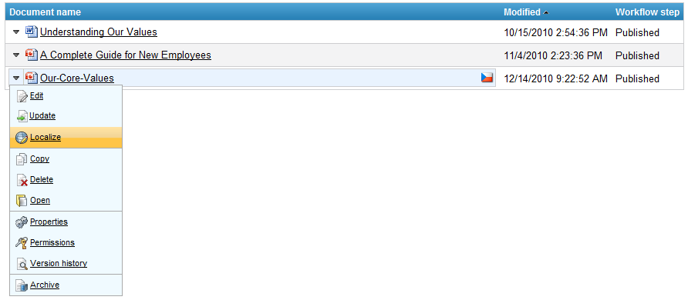
Multi-lingual files
Direct localization of default culture documents

Slide 13
Project management

Slide 14
Overview
Users with appropriate permissions can create and manage a project
Project includes particular tasks
There are owners and assigned users of each task
Project progress is based on the progress of all included tasks
Integrated with Workgroups
Fully customizable statuses and priorities
Ready to use on the live site

Slide 15
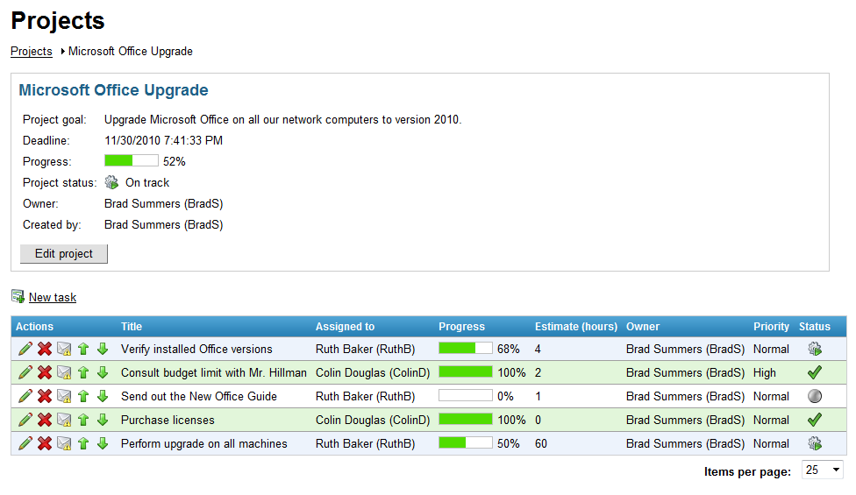
Project info

Slide 16
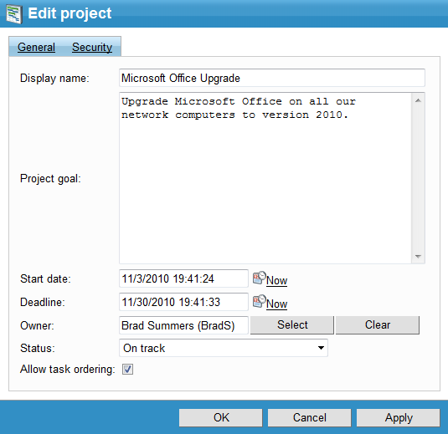
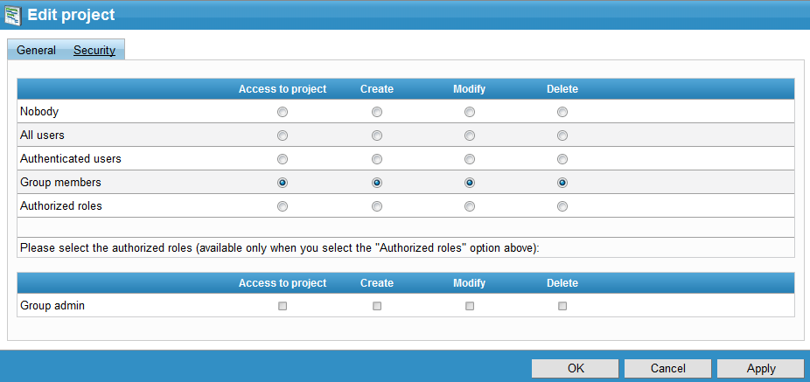
Project management

Slide 17
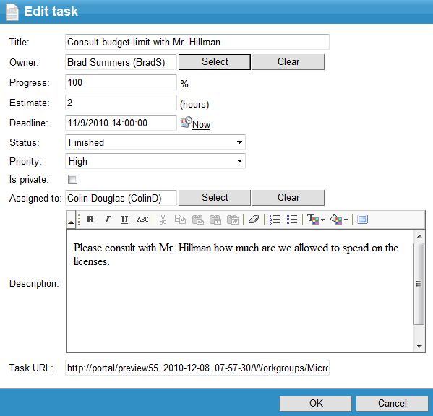
Task management

Slide 18
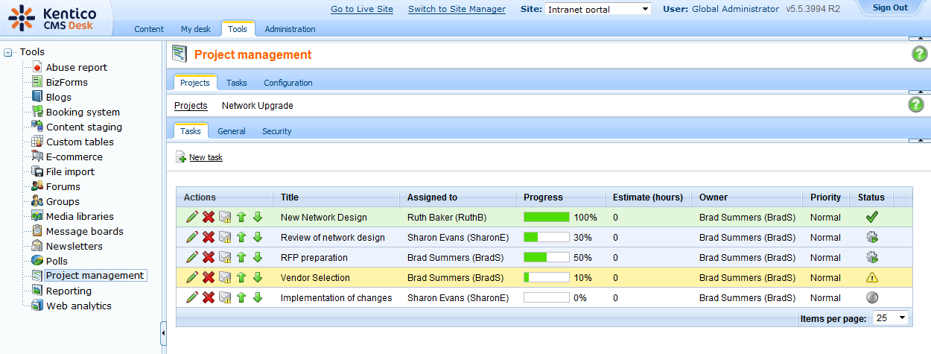
CMSDesk

Slide 19
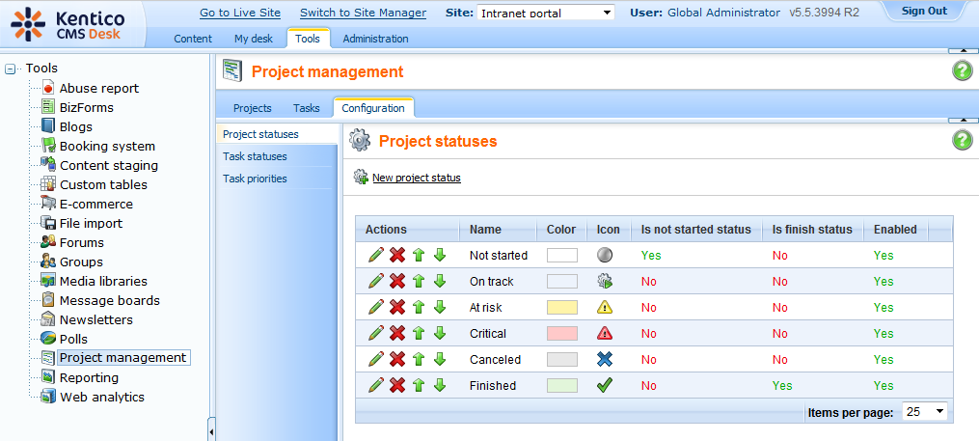
Configuration
You can customize all statuses and priorities

Slide 20
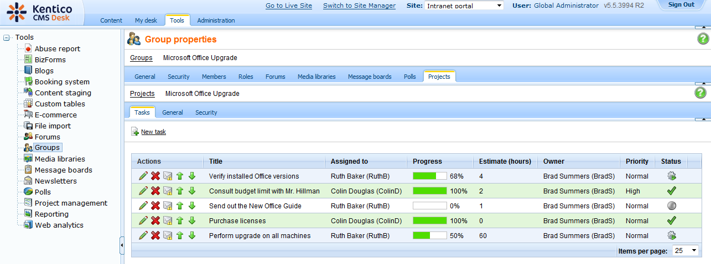
Workgroups - CMSDesk

Slide 21
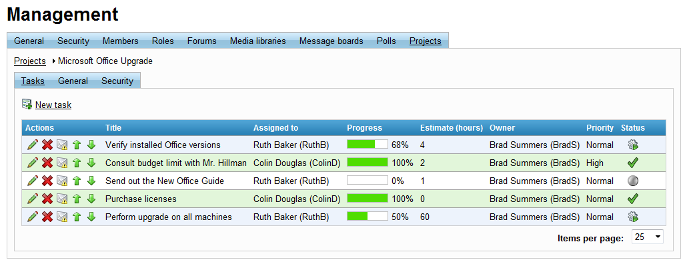
Workgroups – Live site

Slide 22
Personal tasks
Users with appropriate rights can create and manage their own private tasks (not included in any project)
Users can see at any time:
statuses of projects they are members of
statuses of tasks they own
statuses of tasks assigned to them

Slide 23
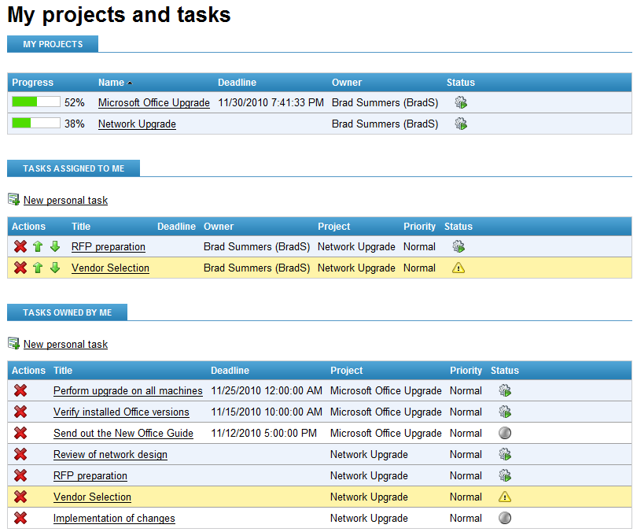
Current projects & tasks status

Slide 24
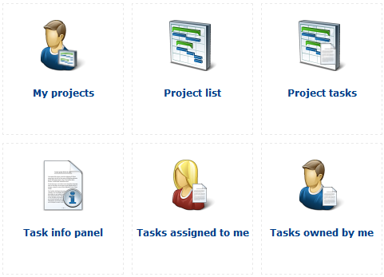
Web parts & Widgets

Slide 25
Intranet solution

Slide 26
Overview
Out-of-the-box, ready-to-use solution for your Enterprise 2.0 Intranet that boosts your team collaboration and co-operation
It covers all the necessary functionality:
Corporate identity, policy documents, canteen menu, employees directory, …
Blogs, Forums, Wikis, News, Corporate events
Document libraries, Media libraries
Project management
Team workgroups
Company Departments
and many others …..
Each part of the Intranet website is fully customizable

Slide 27
User contribution
Based on assigned permissions, user can create and manage any type of document directly on the live site, without any access to the administration UI

Slide 28
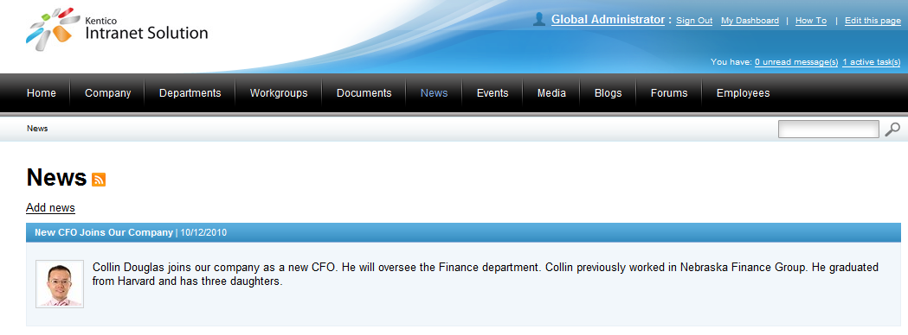
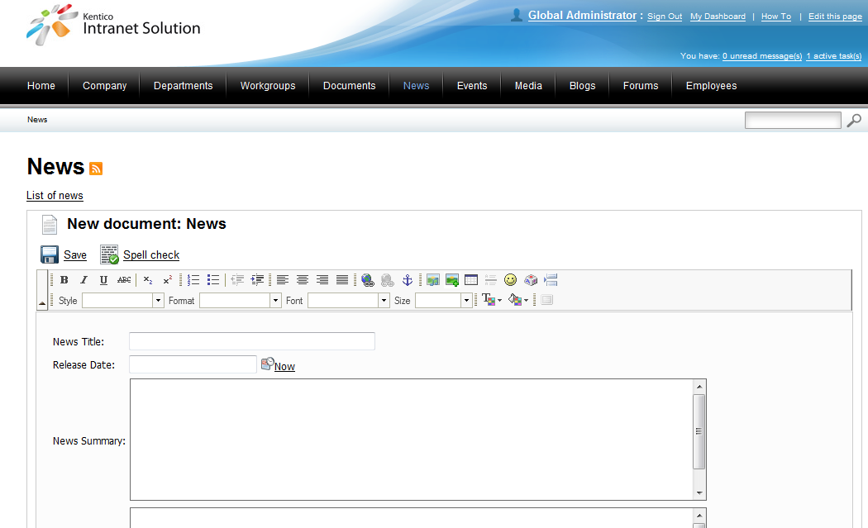
User contribution

Slide 29
The basics
Intranet Solution is divided into four parts:
Main portal
Departmental websites
Workgroups
My Dashboard

Slide 30
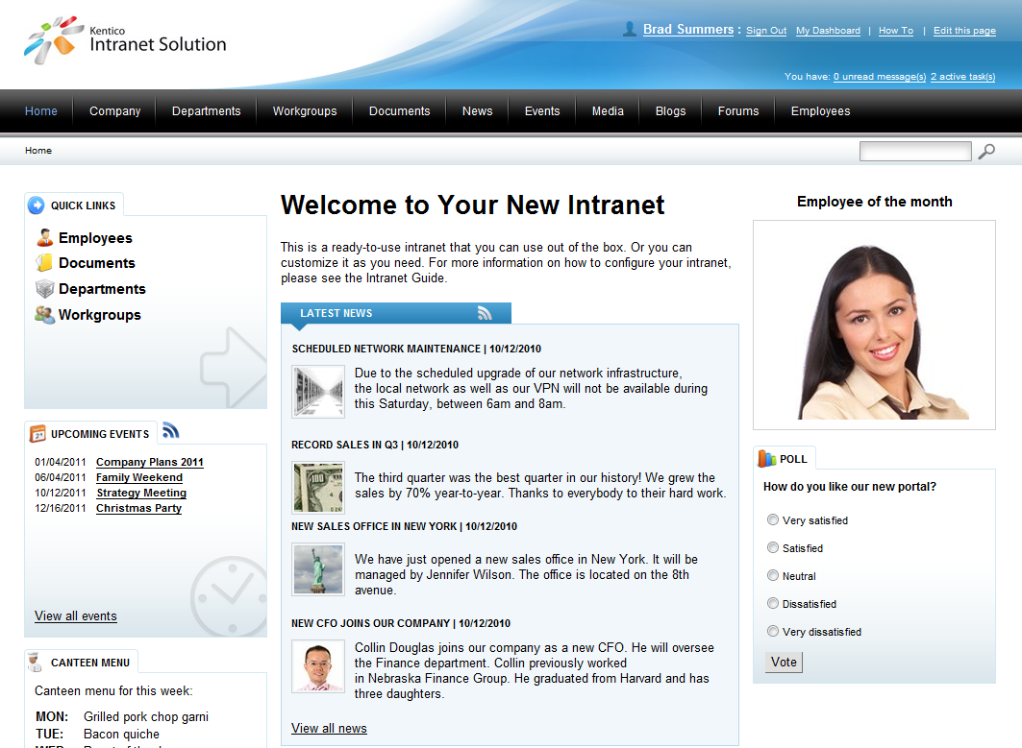
Main portal

Slide 31
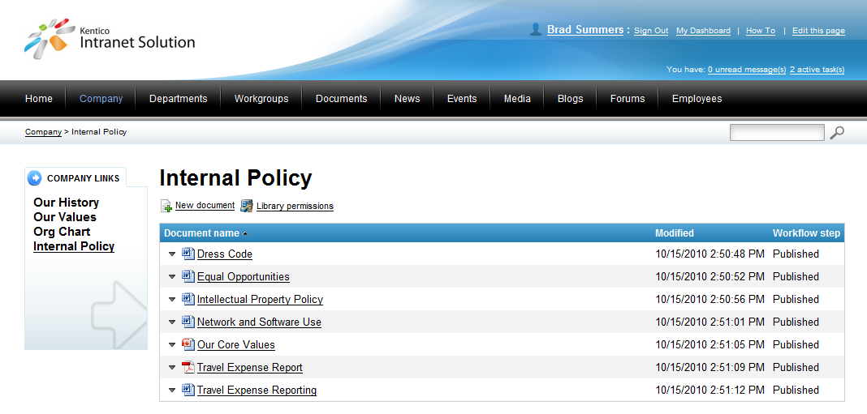
Company focused documents

Slide 32
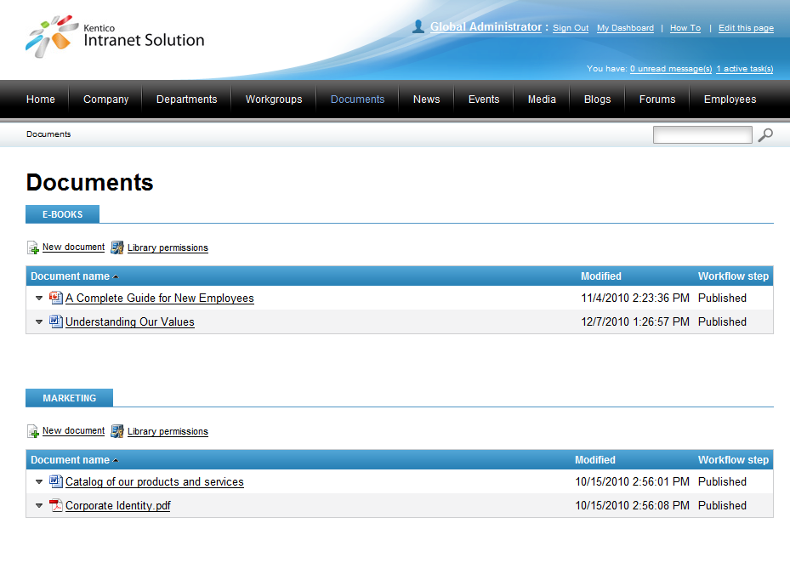
Internal Document Libraries

Slide 33
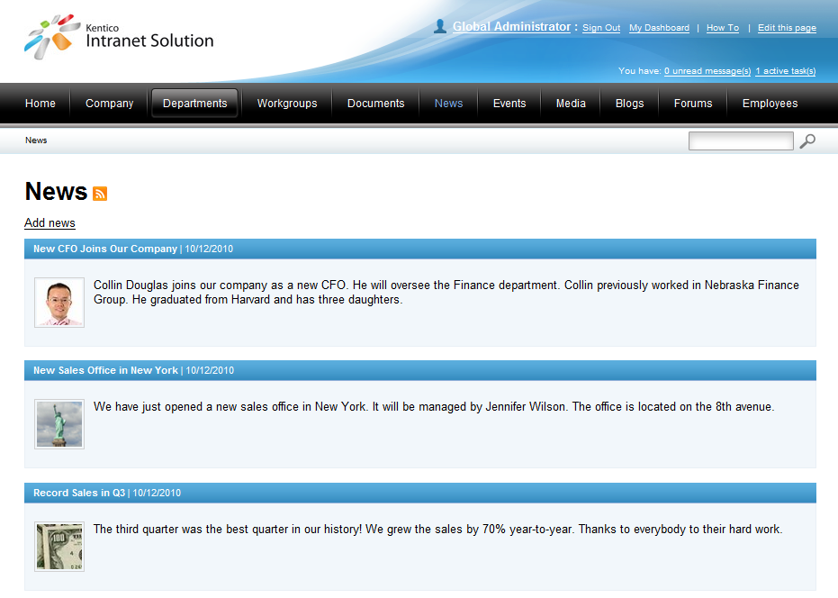
Corporate News

Slide 34
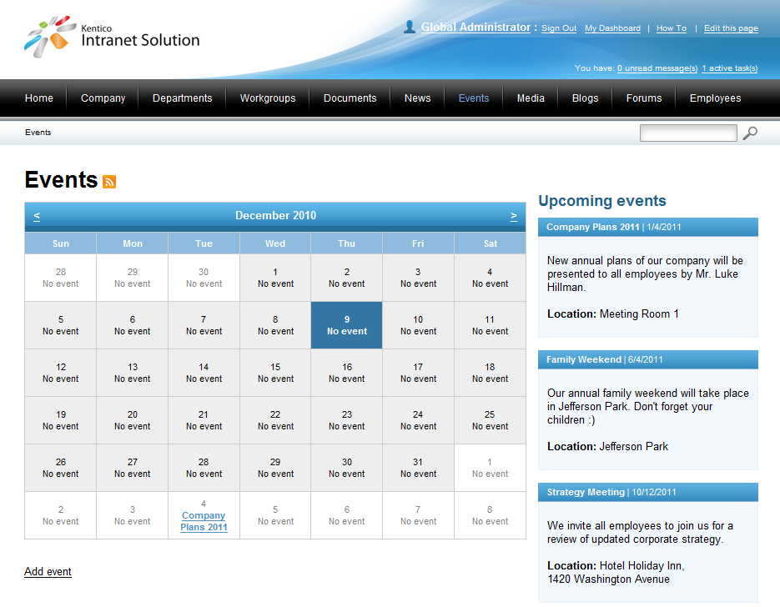
Company Events

Slide 35
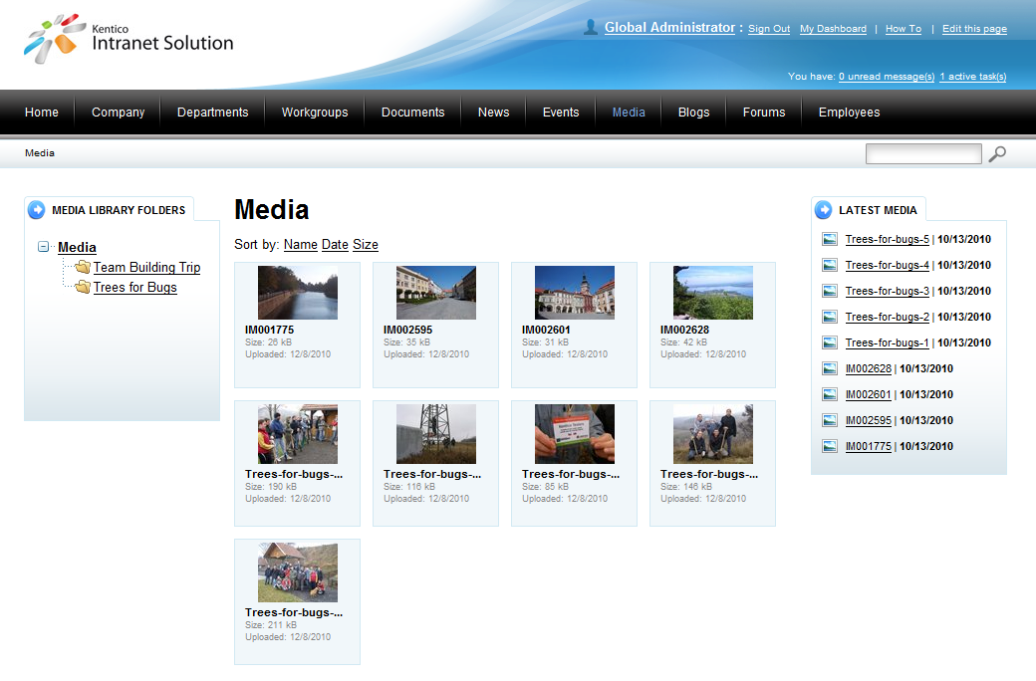
Multimedia sharing

Slide 36
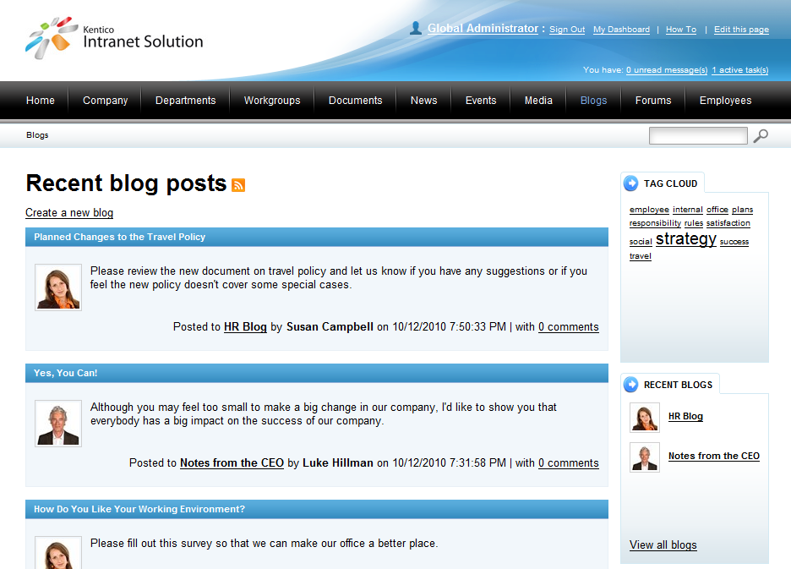
Blogs for all employees

Slide 37
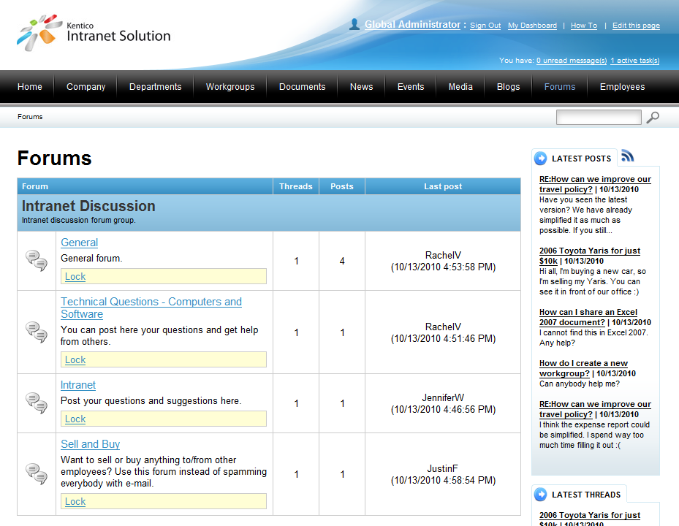
Internal forums

Slide 38
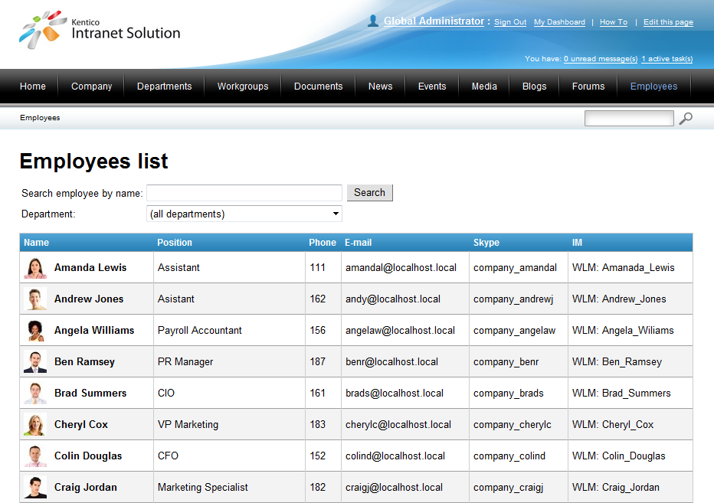
Employees directory

Slide 39
Powerful portal search
Indexing and searching of all publicly available information and documents including blogs, forums, document libraries, etc.
Including PDF and Office documents!

Slide 40
Departments
Reflect company organization
Each department is represented as a separate website
Department documents are accessible by department members only
Each department can use a different design schema
Only administrators can create and manage departments

Slide 41
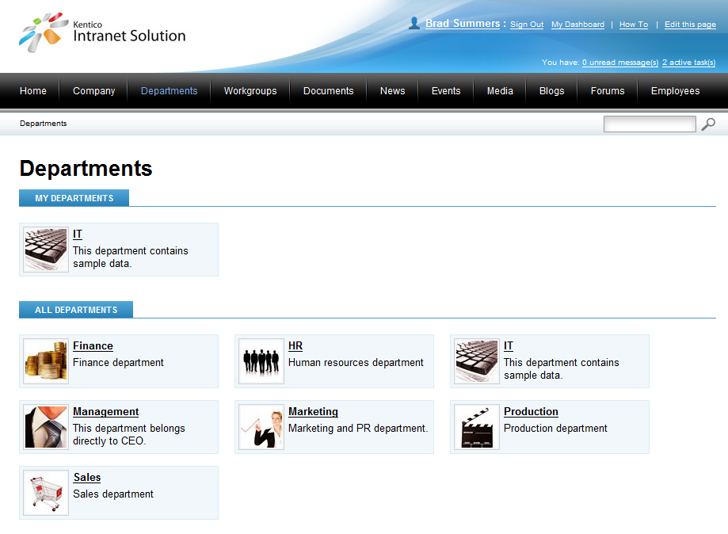
Departments

Slide 42
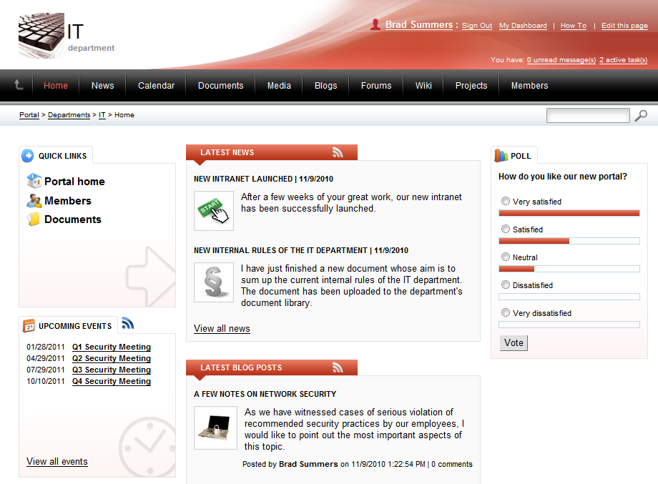
Department website

Slide 43
Workgroups
Efficient tool for the team collaboration and co-operation
Each workgroup is represented as a separate website
Workgroup documents can be private (viewed by workgroup members only) or public
Each workgroup can use different design schema
Any intranet user can create a workgroup
Workgroup administrators can modify the homepage of their workgroup‘s sub-portal

Slide 44
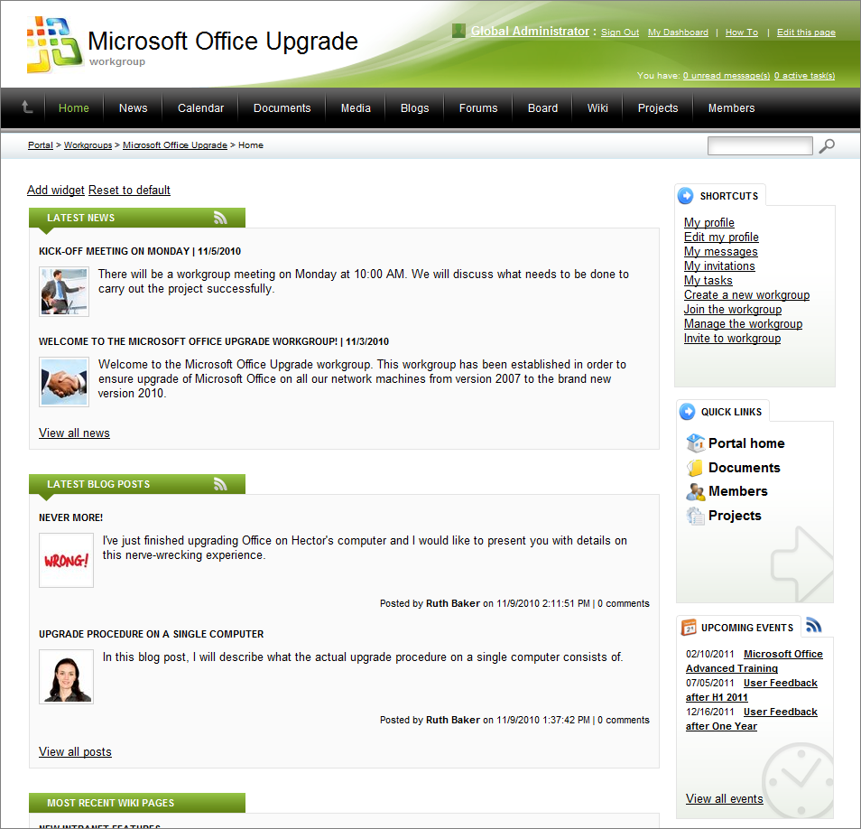
Workgroup website

Slide 45
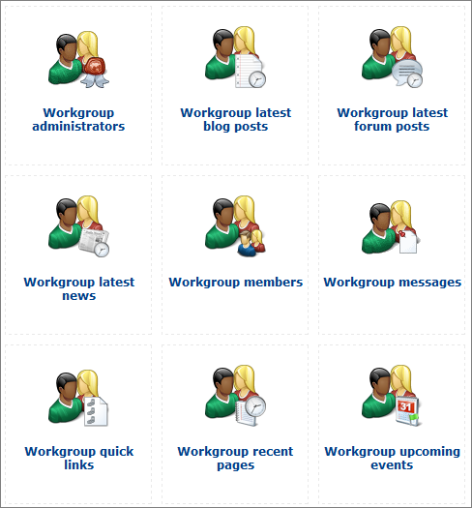
Workgroups widgets

Slide 46
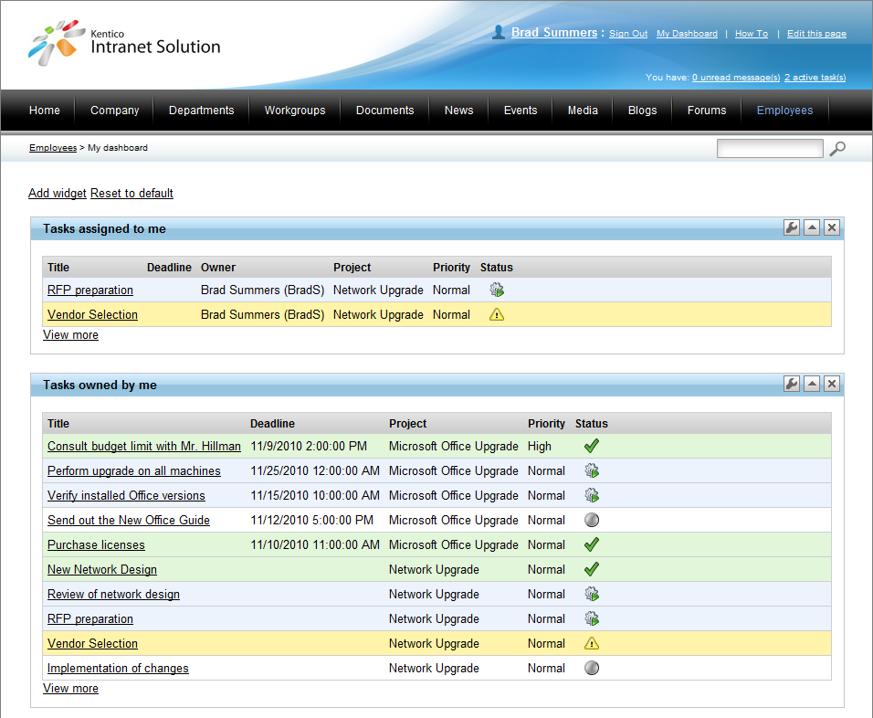
My Dashboard
Personalized webpage via widgets

Slide 47
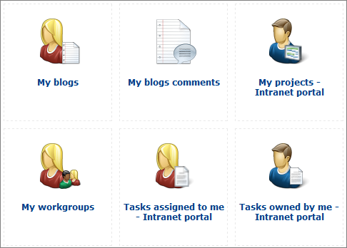
My Dashboard widgets

Slide 48
Customization
There are prepared web parts and widgets we can use for customization
Content editors can customize the Home page of the whole portal
Workgroup owners can customize the Home page of their workgroups
Any user can customize MyDashboard

Slide 49
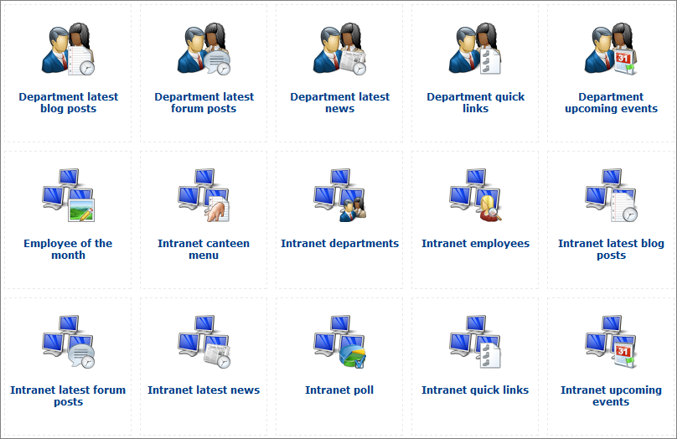
Web parts & Widgets

Slide 50
Multi-lingual intranets
Kentico Intranet Solution supports multi-cultural intranets including multi-cultural document libraries

Slide 51
Documentation
Kentico Intranet Solution comes with two documentation guides:
User’s guide focused on end-users
Admin’s guide for content editors, designers, developers and administrators

Slide 52
Windows azure

Slide 53
Windows Azure
Windows Azure is a Cloud computing platform delivered by Microsoft Corporation
Offers SQL Azure (based on SQL Server)
SQL Full-text is not ready for Windows Azure yet
Supports ASP.NET development

Slide 54
Limited feature set
Kentico CMS 5.5 R2 on Windows Azure has the following limitations:
Doesn’t support any file-based operations (import/export, Smart Search, Media libraries)
Supports only Single Instance

Slide 55
Licensing

Slide 56
Licensing
Document Management Package (from $1,499) includes:
Document management
Project management
Task management
WebDAV support
Cloud hosting no longer requires cloud license
Licensed per cloud instance as in web farms
Ultimate edition
NO PRICE CHANGES!!!

Slide 57
How to reach us?
http://www.facebook.com/KenticoCMS
http://twitter.com/kenticocms
http://kentico.uservoice.com/
Suggest new Kentico CMS features

